Slide 1
B- Purchasing Module

Slide 2
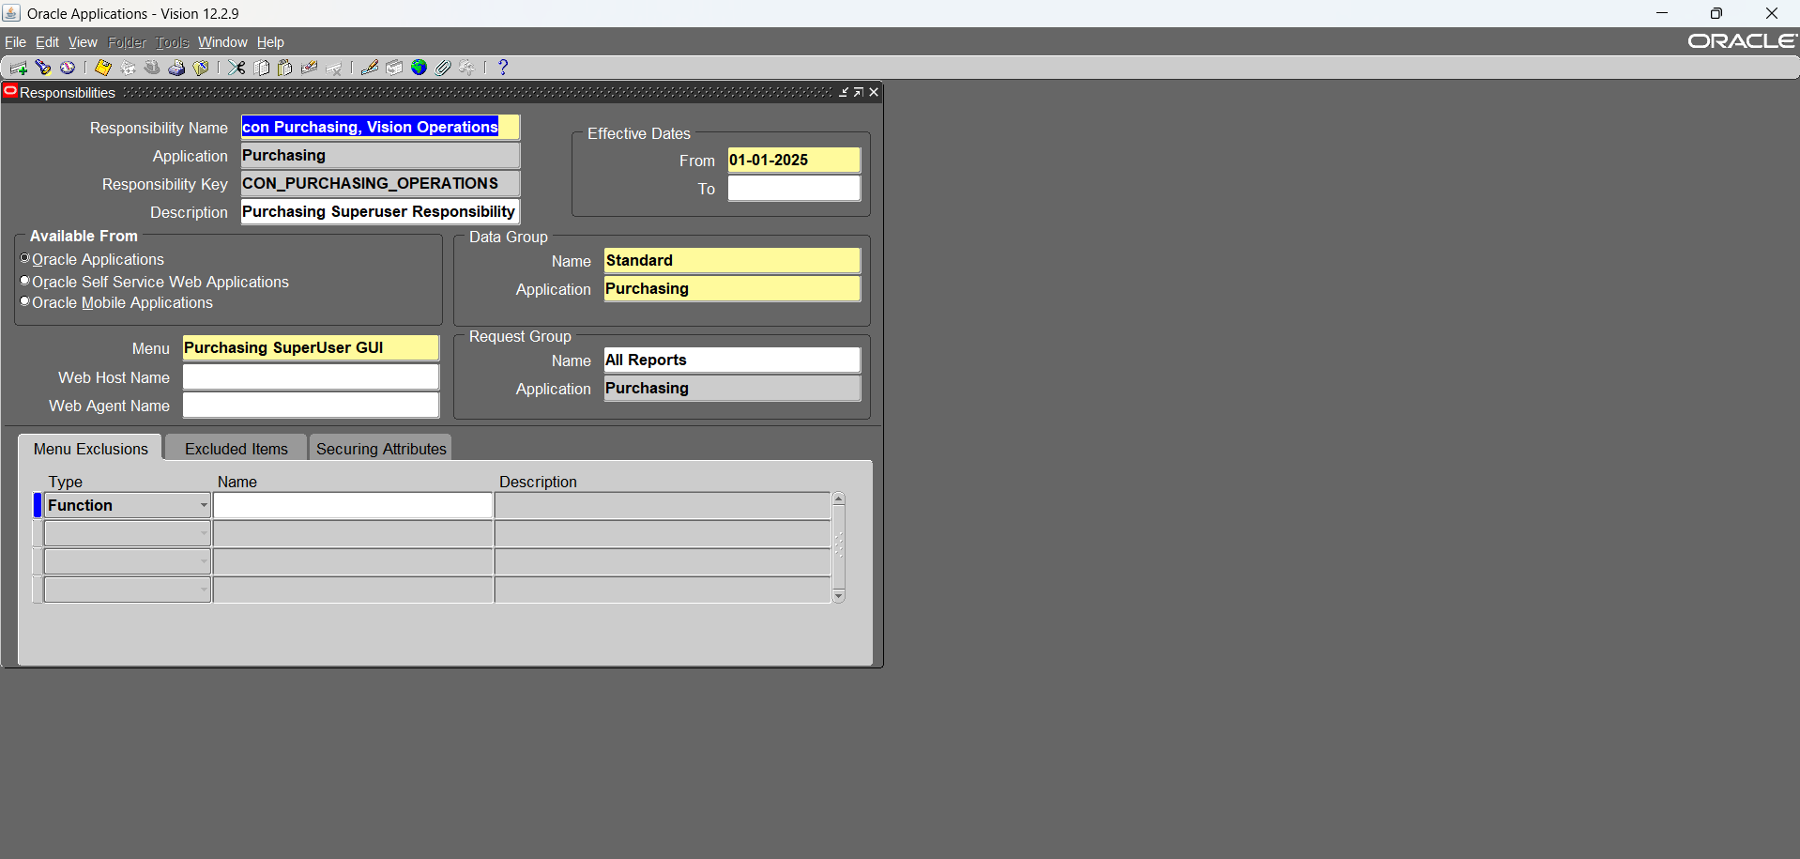
1- Create new purchasing responsibility

Slide 3
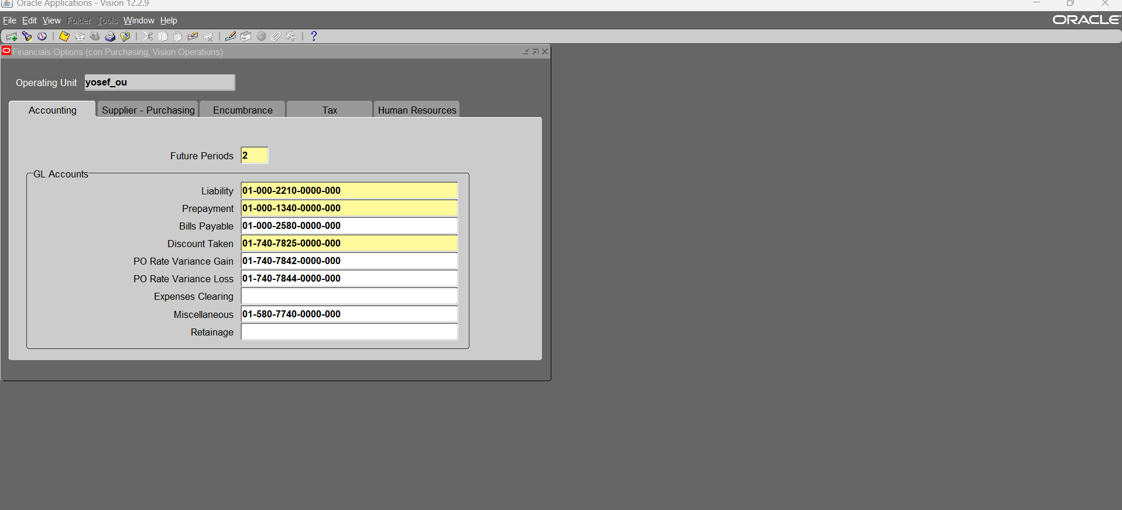
2- Define financial options for Operating unit (to use new purchasing responsibility)

Slide 4
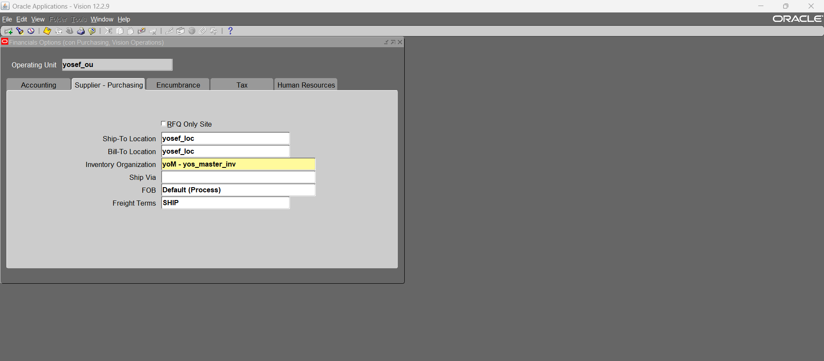

Slide 5
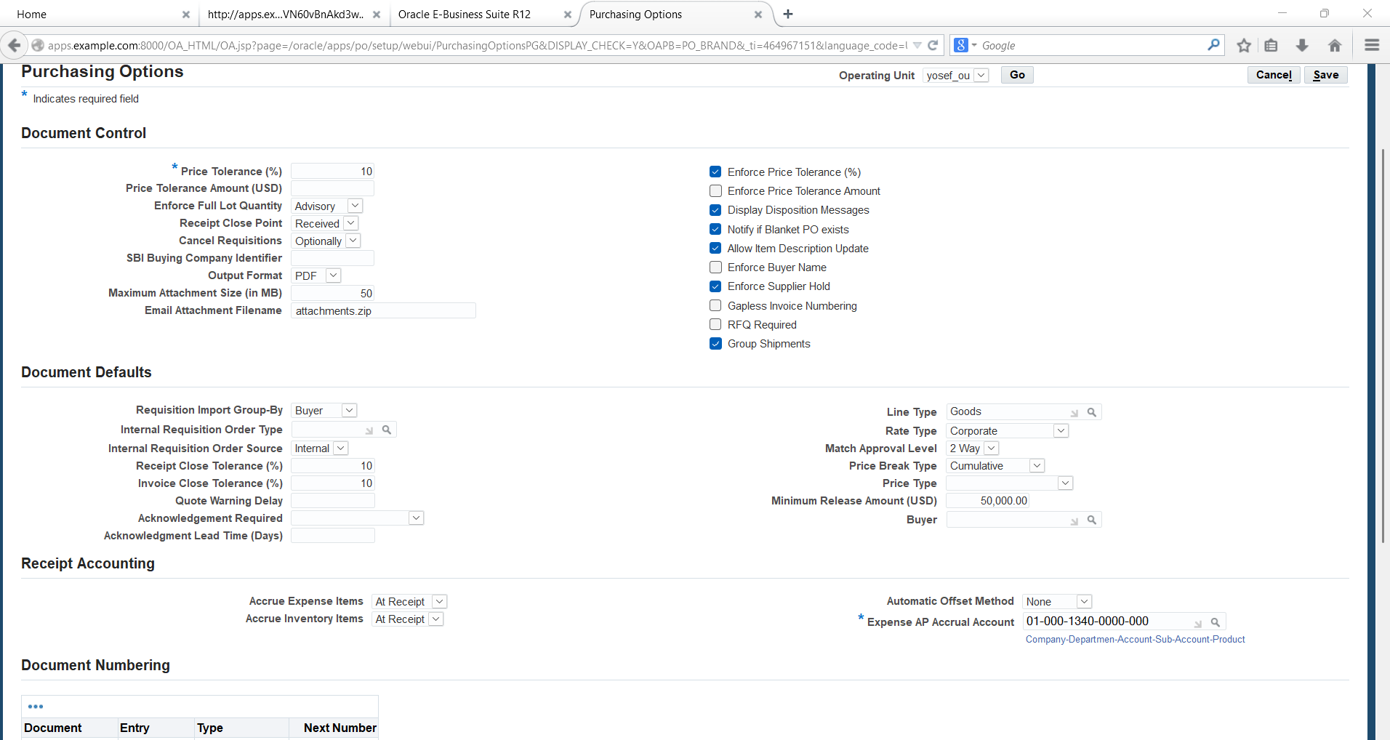
3- Define purchasing options for new purchasing responsibility

Slide 6
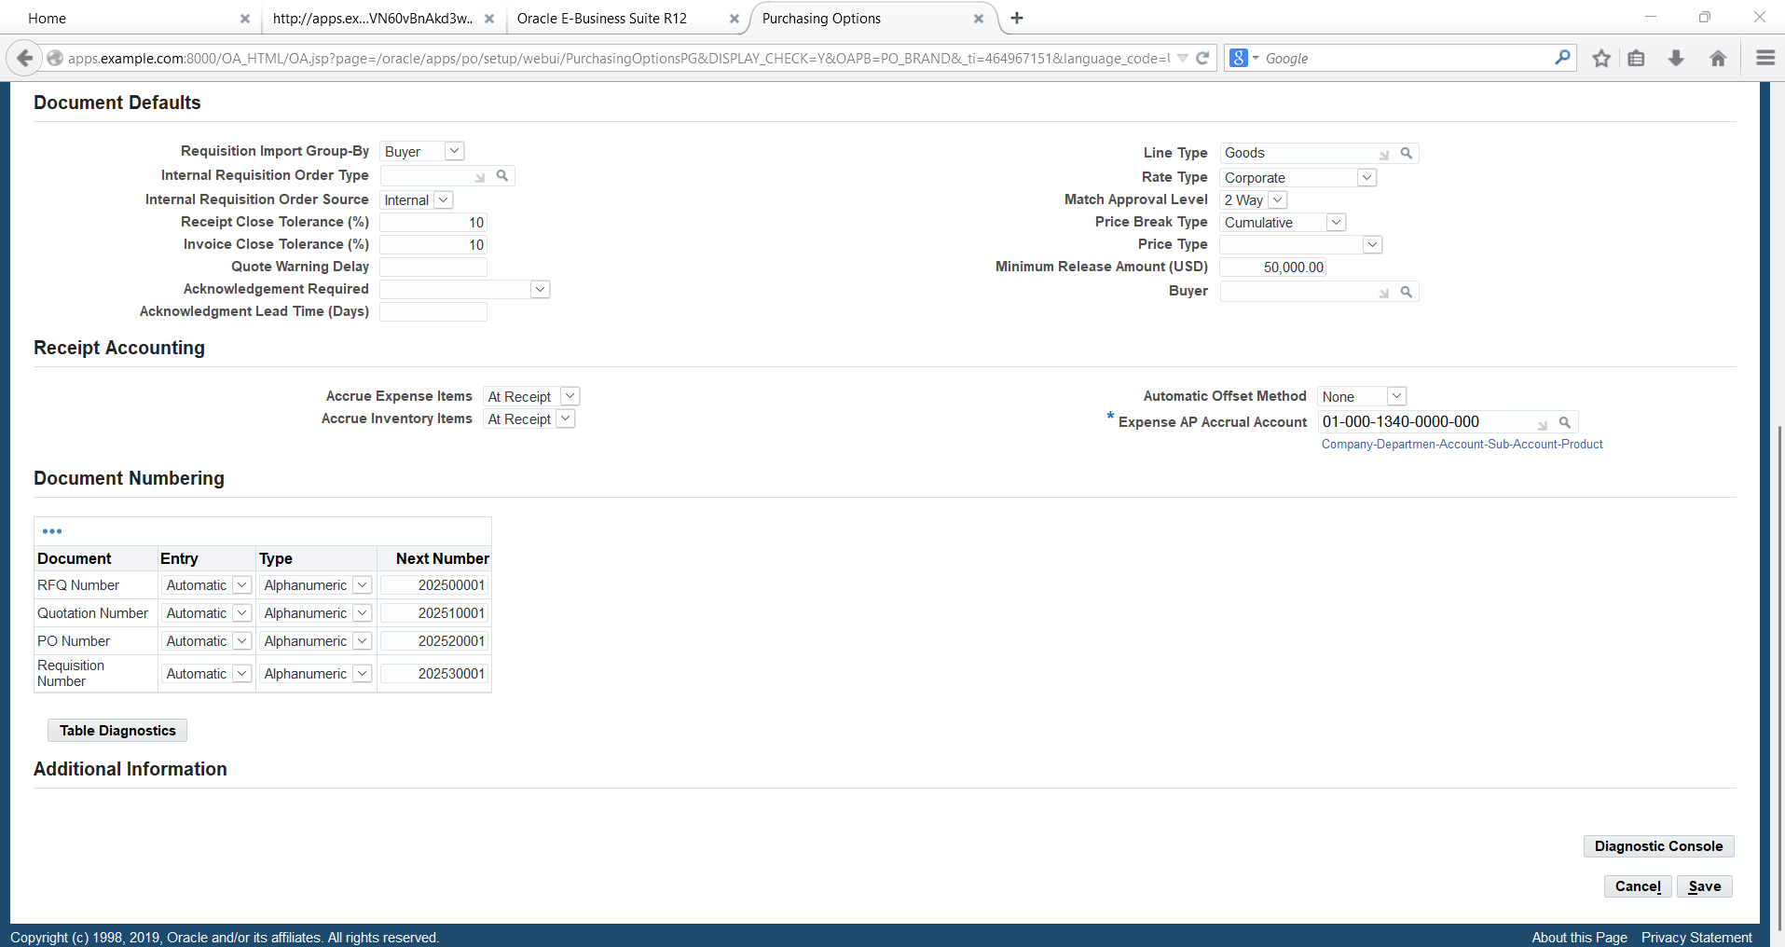

Slide 7
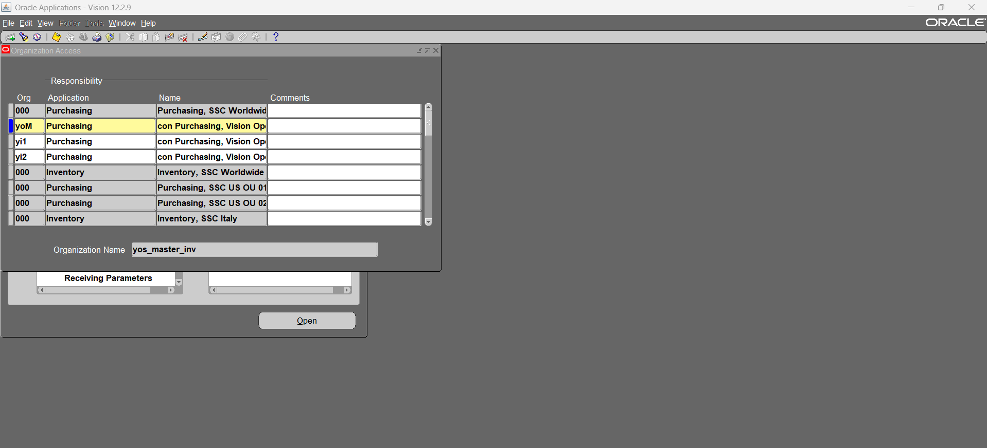
4- Define organization access for new purchasing responsibility

Slide 8
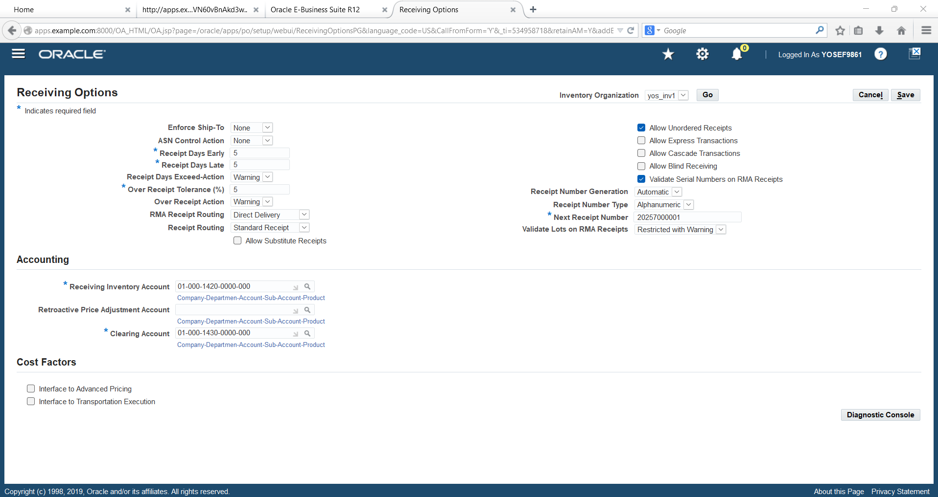
5- Define receiving options for new purchasing responsibility

Slide 9
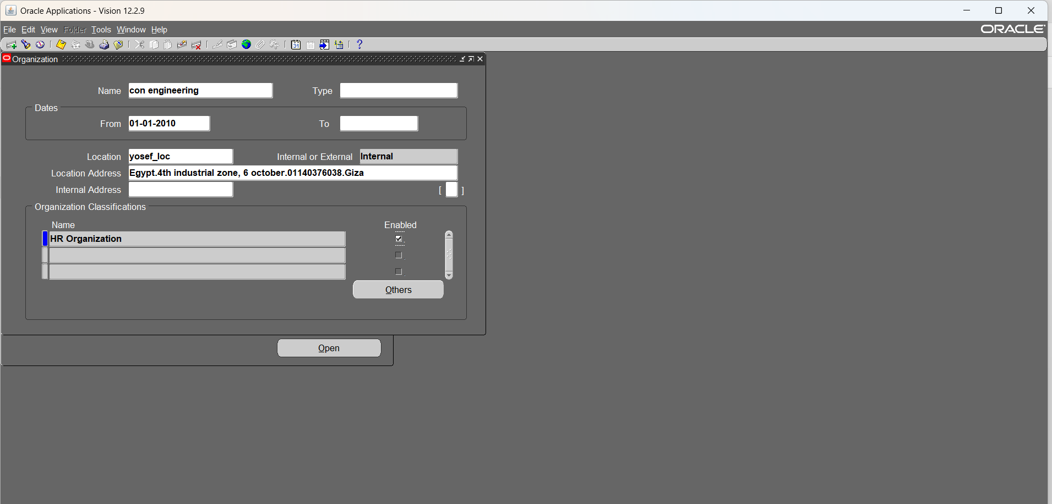
6- Create new departments “HR Organizations – to assign positions to it” (to use them at organization hierarchy) – global HRMS, work structure, organization

Slide 10
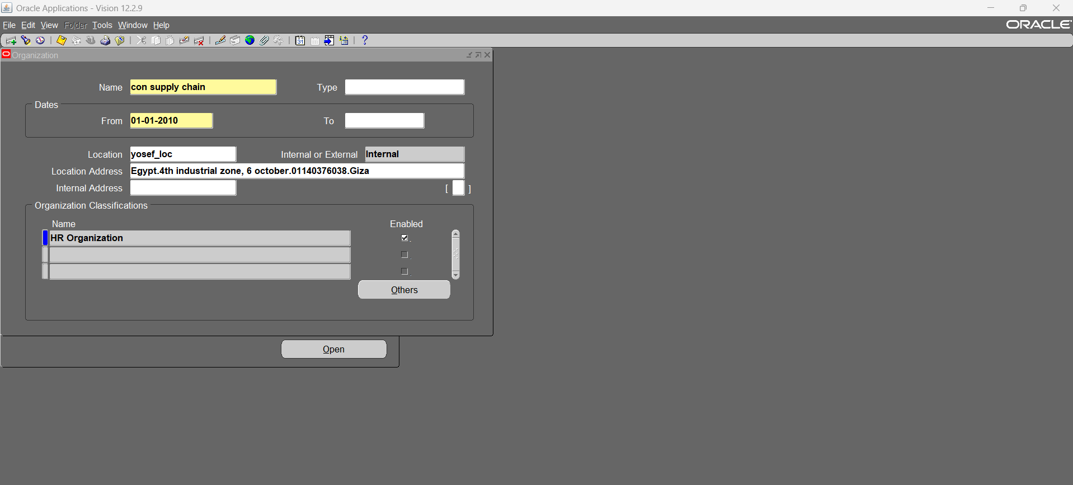
6.1- supply chain department

Slide 11
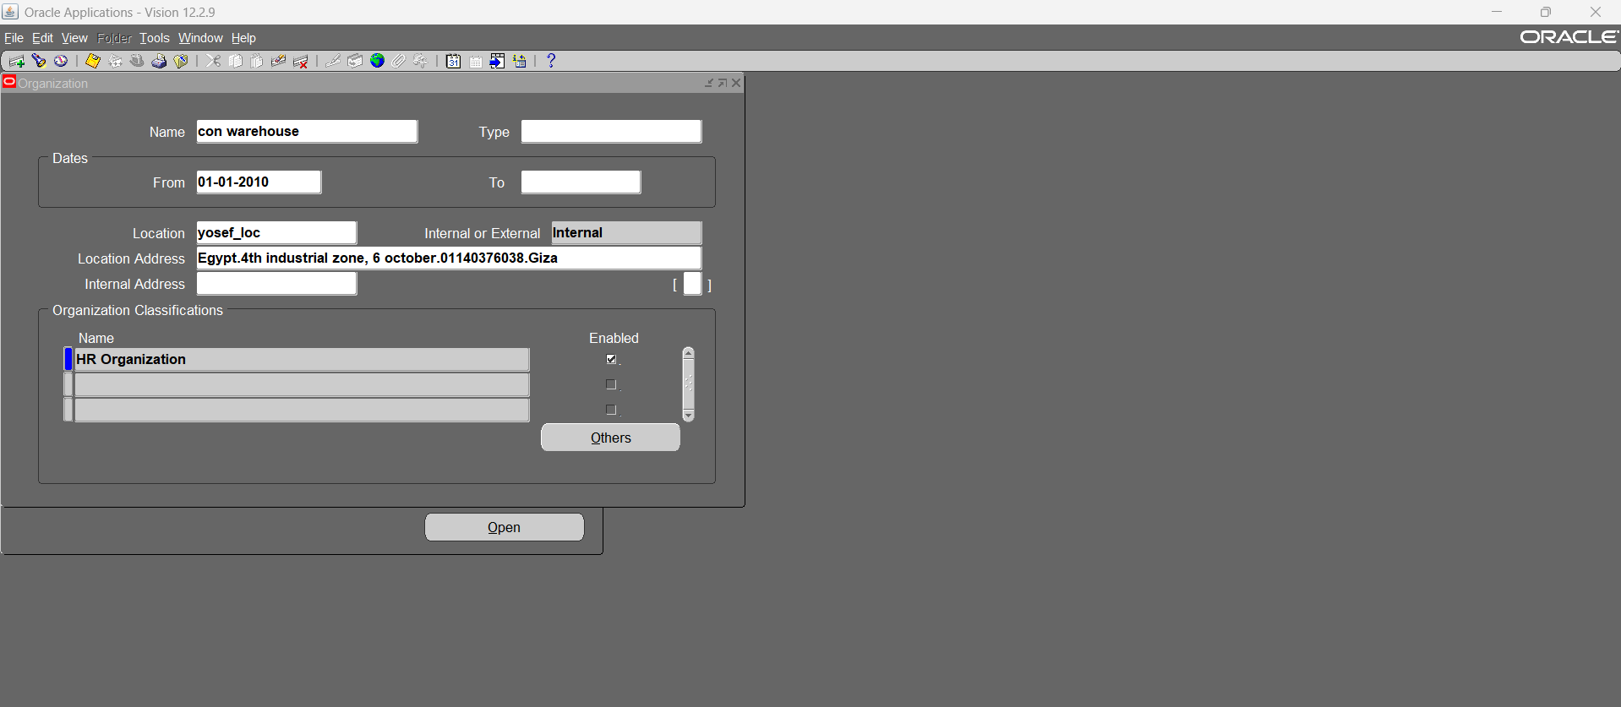
6.2- warehouse department

Slide 12
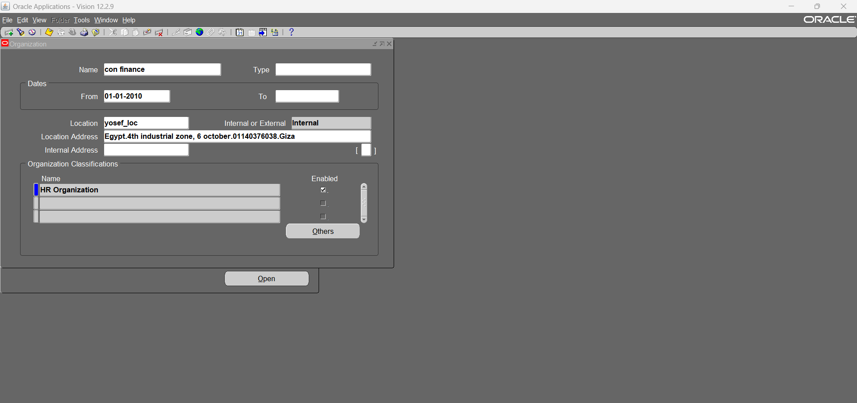
6.3- finance department

Slide 13
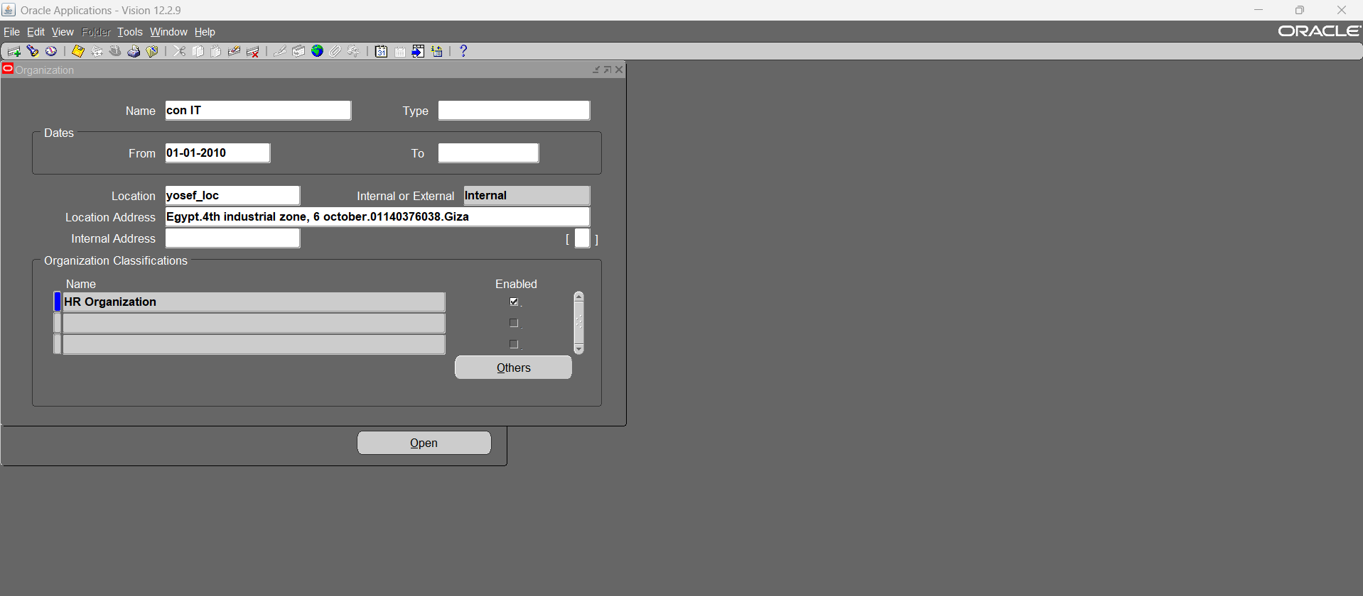
6.4- IT department

Slide 14

6.5- top management department

Slide 15
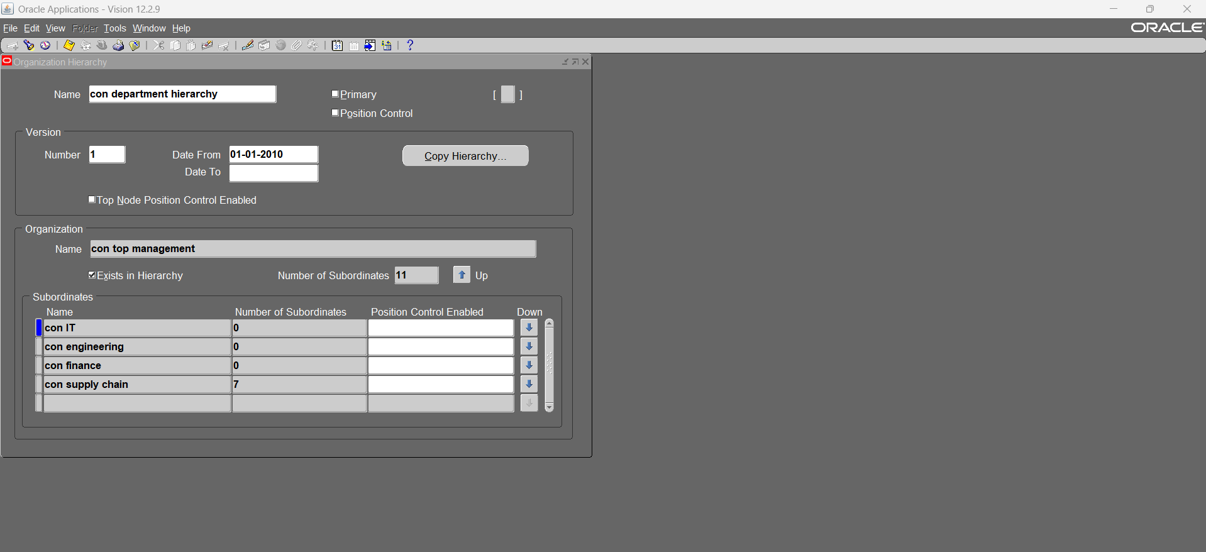
7- create new organization hierarchy (Department or Supervision hierarchy) - global HRMS, work structure, organization, hierarchy

Slide 16
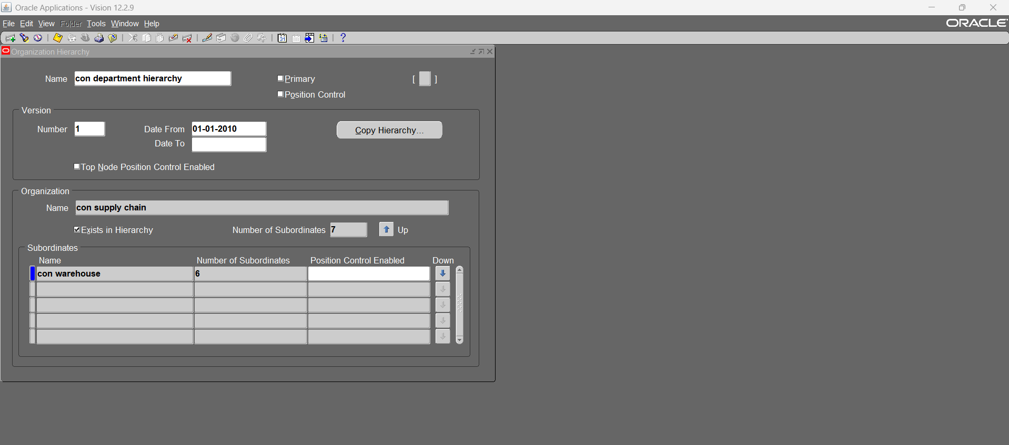
7.1- supply chain department

Slide 17
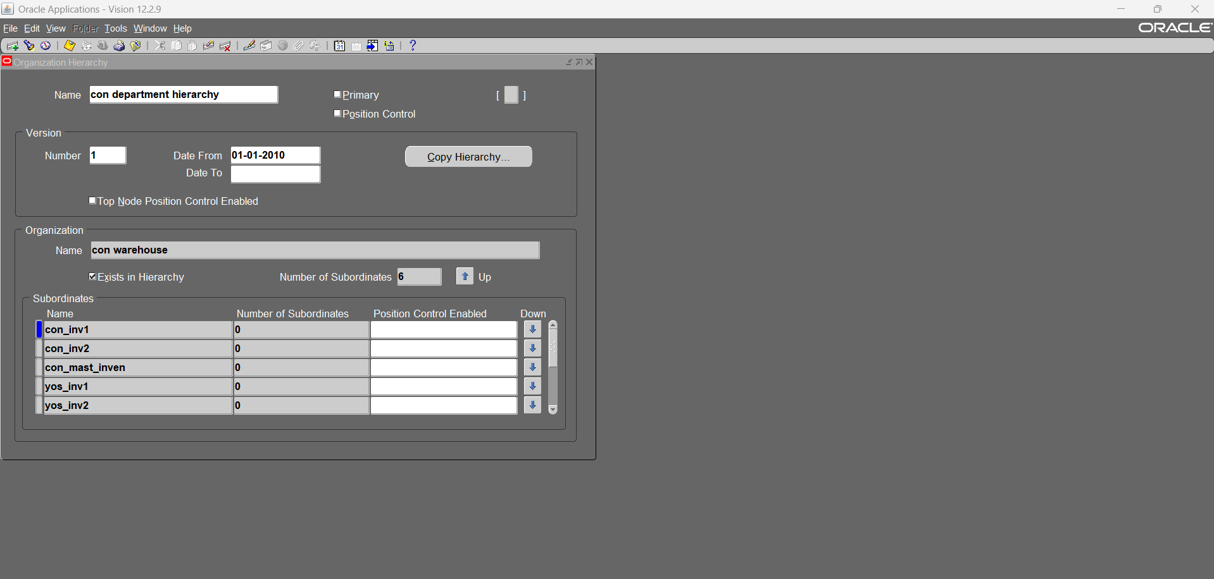
7.2- warehouse department

Slide 18
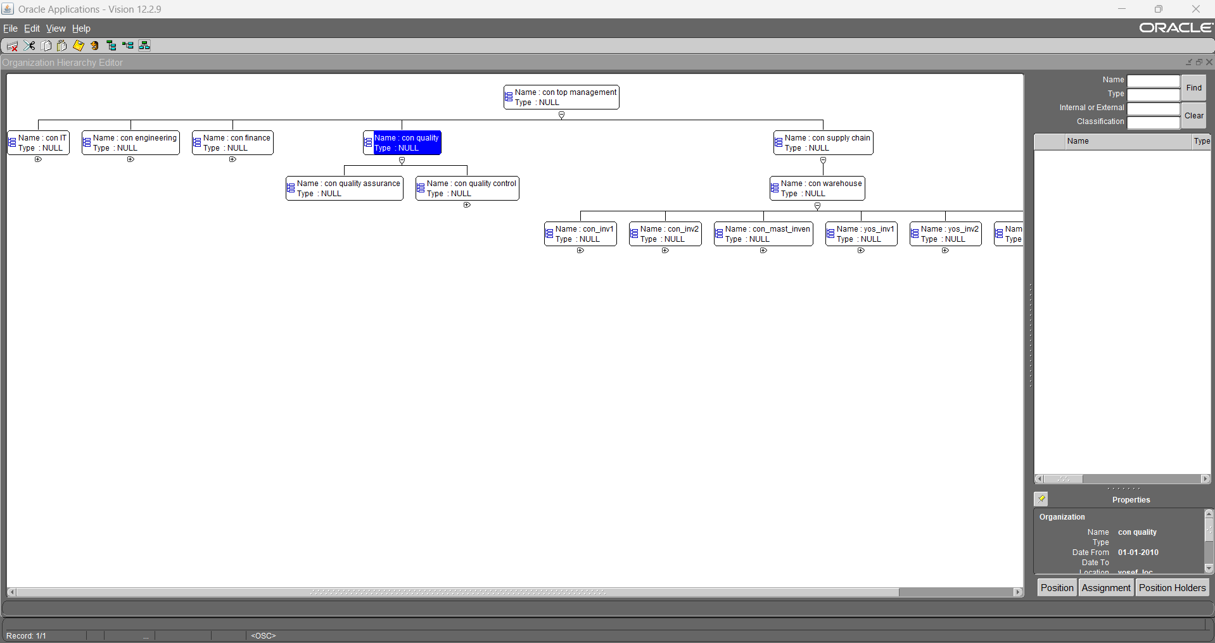
7.3- organization supervisor hierarchy diagrammer

Slide 19
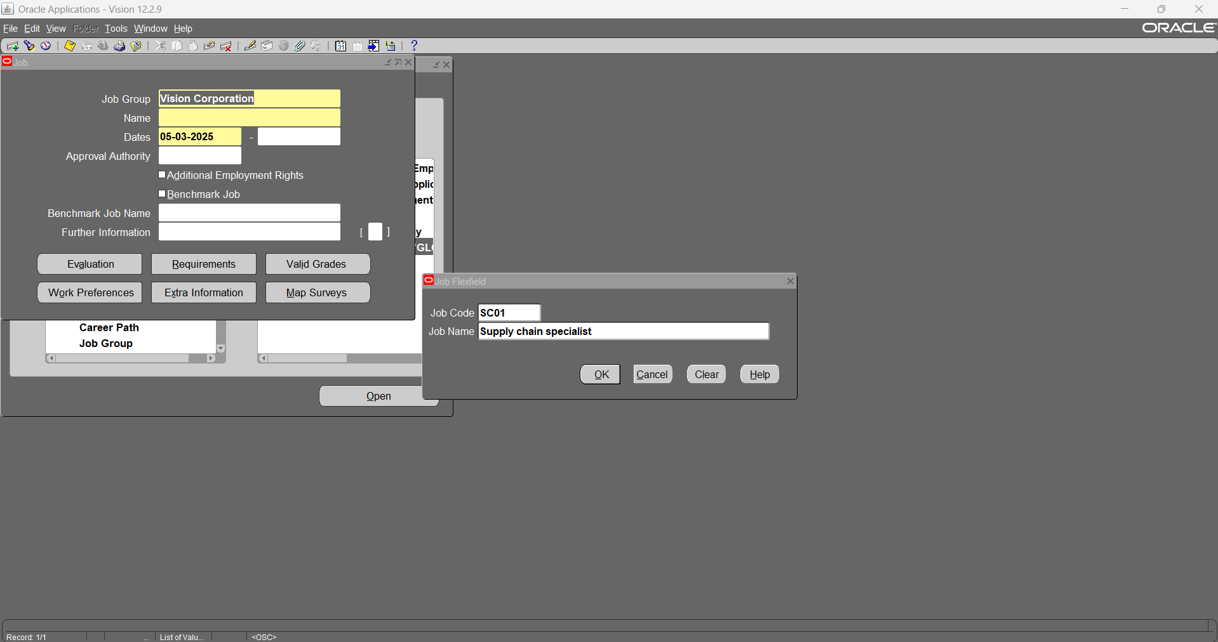
8- Define new jobs

Slide 20
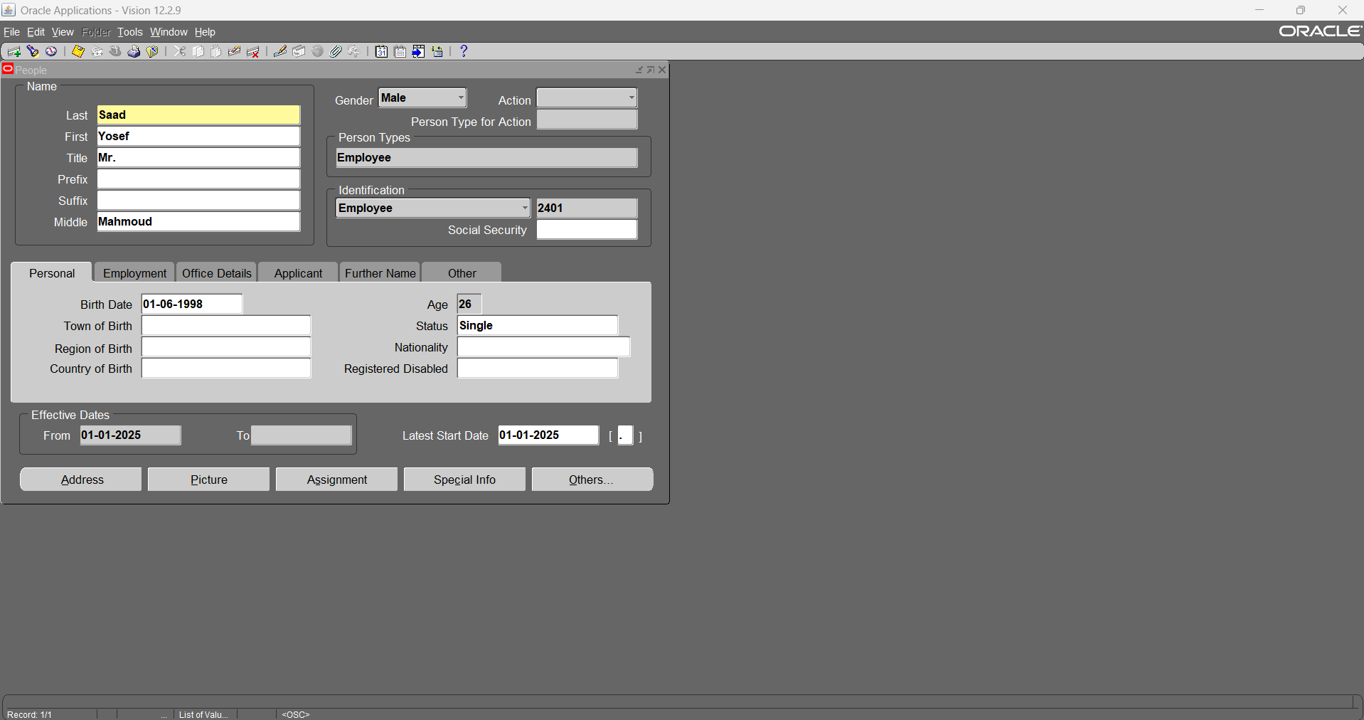
9- Assign jobs and supervisor to employees

Slide 21
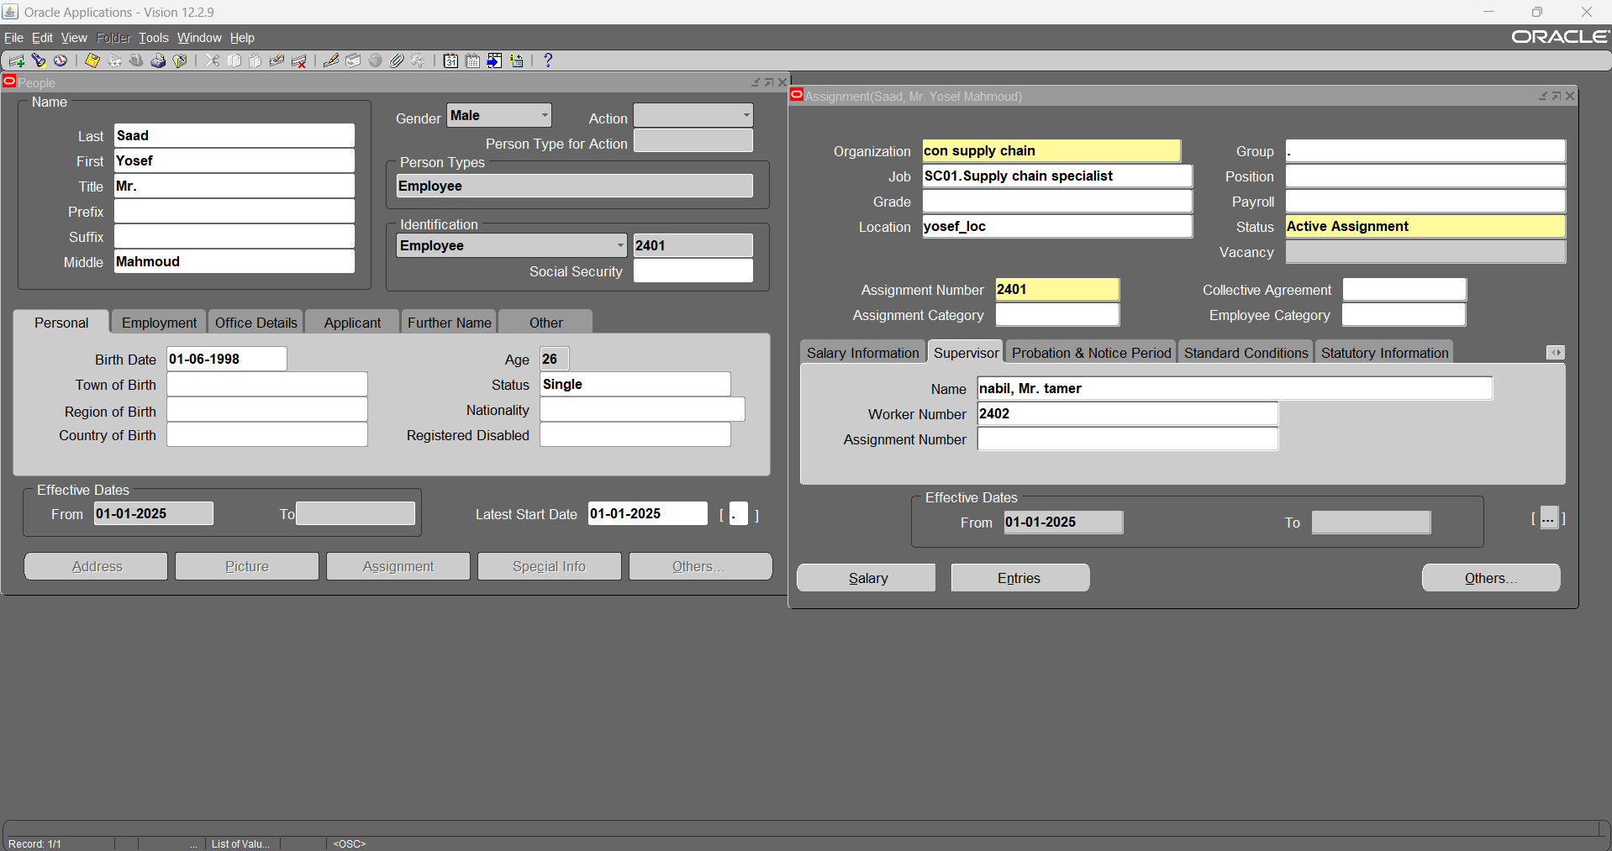

Slide 22
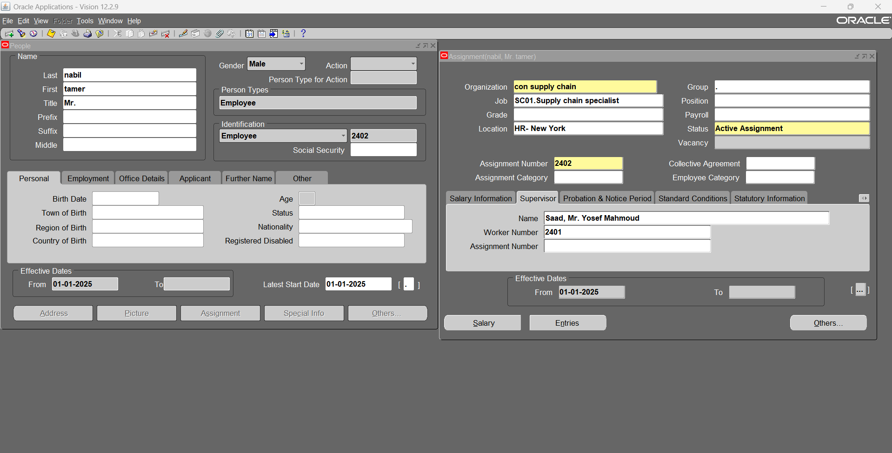

Slide 23
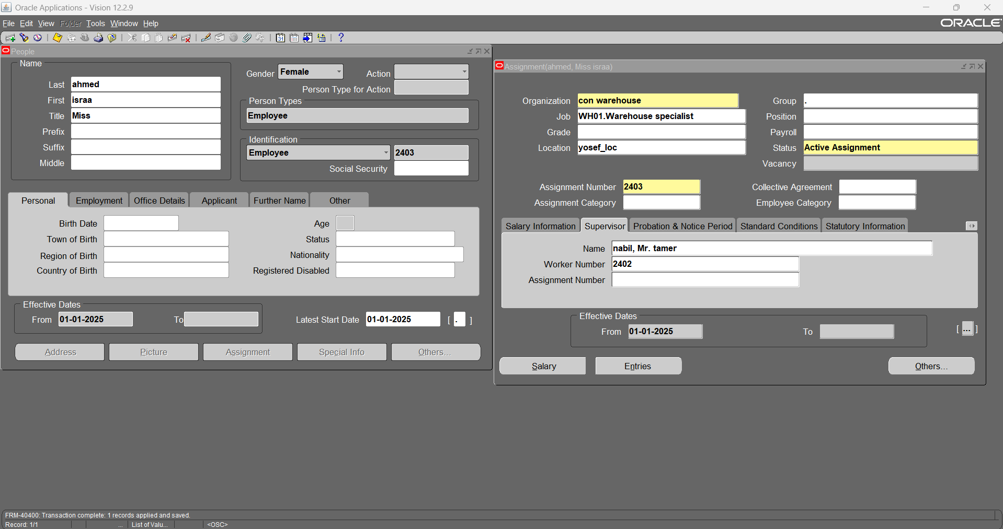

Slide 24
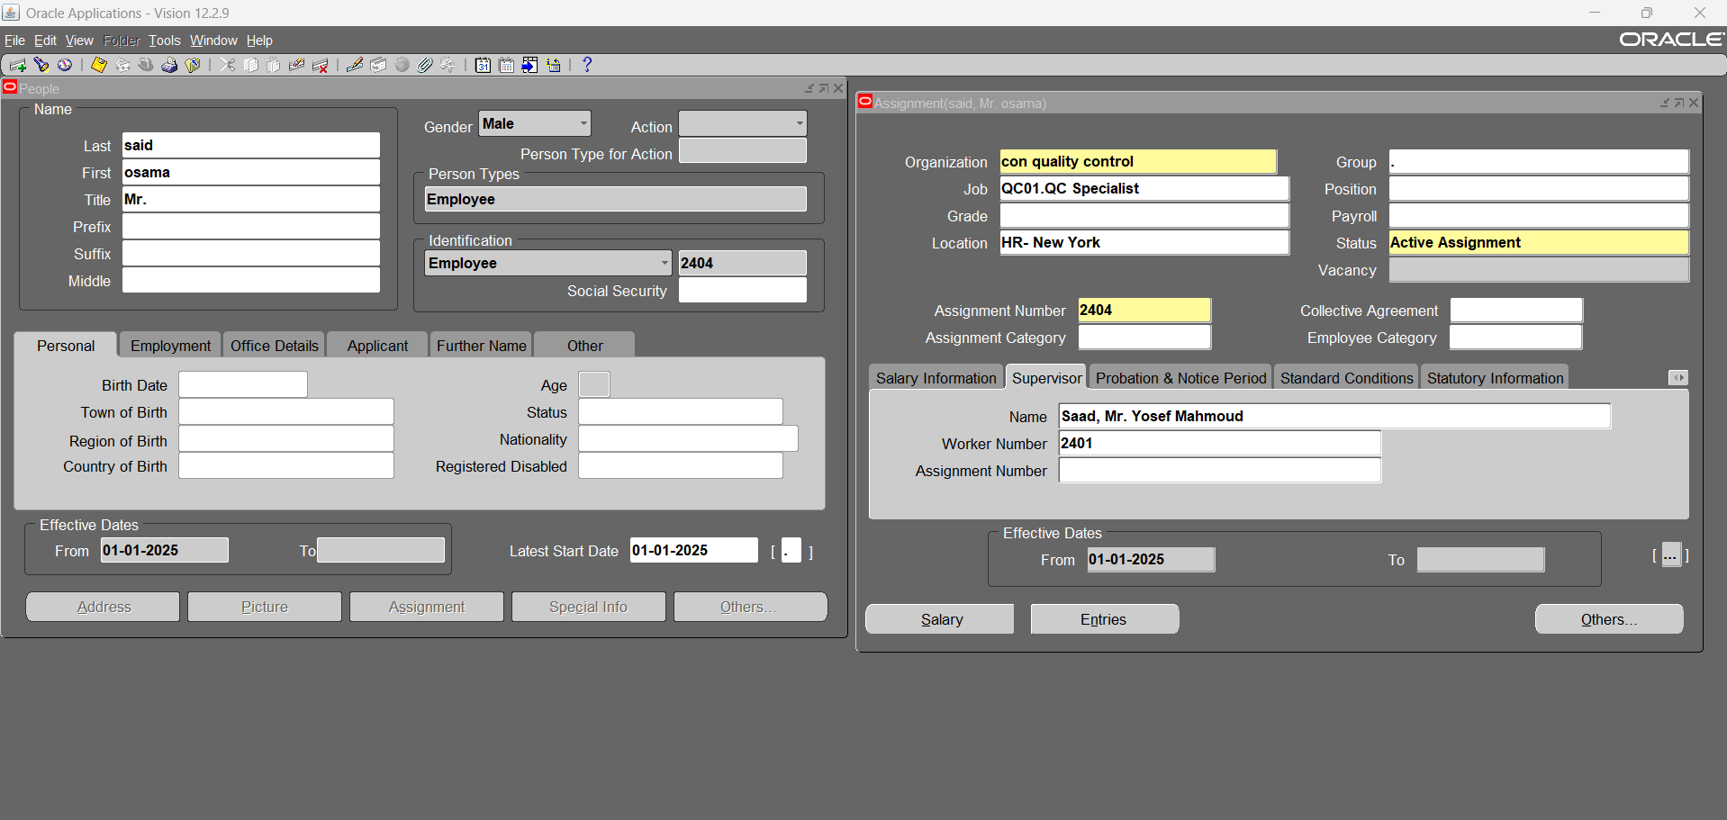

Slide 25
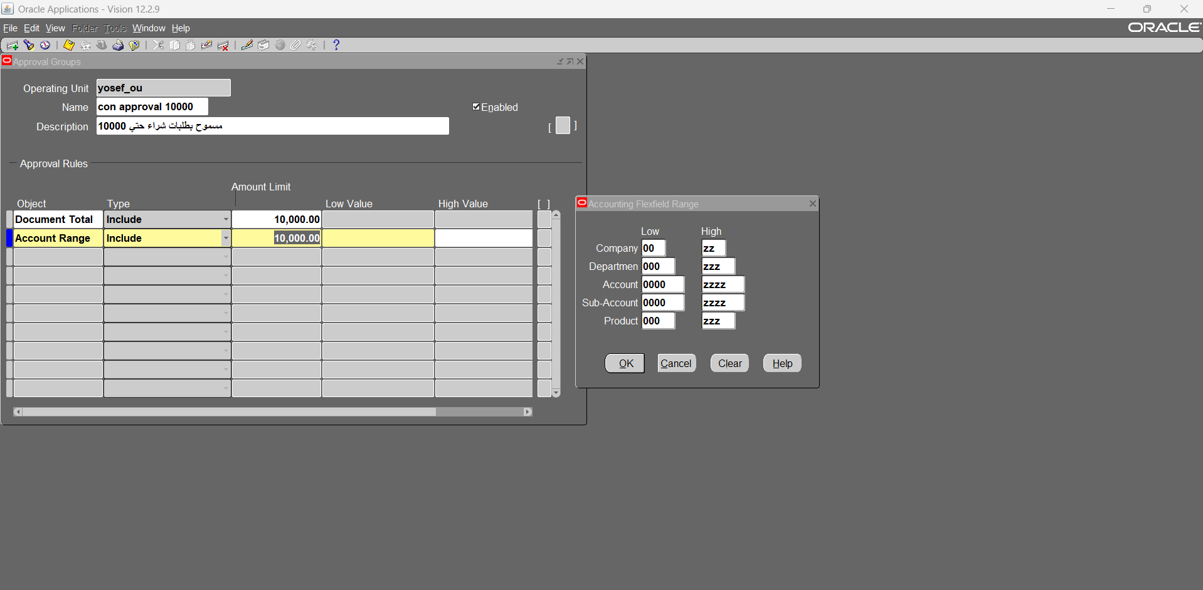
10- Create new approval groups

Slide 26
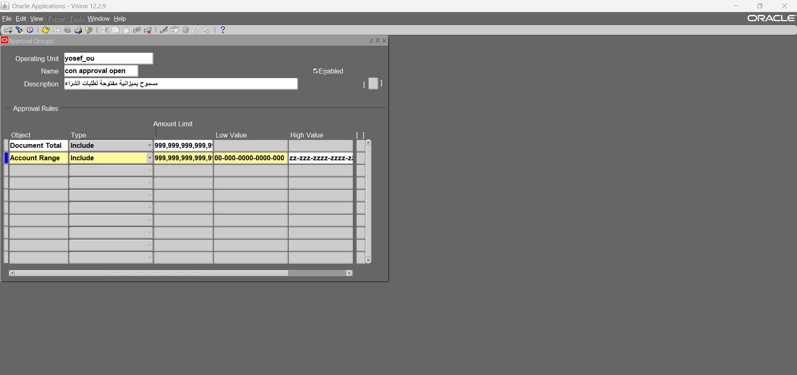

Slide 27
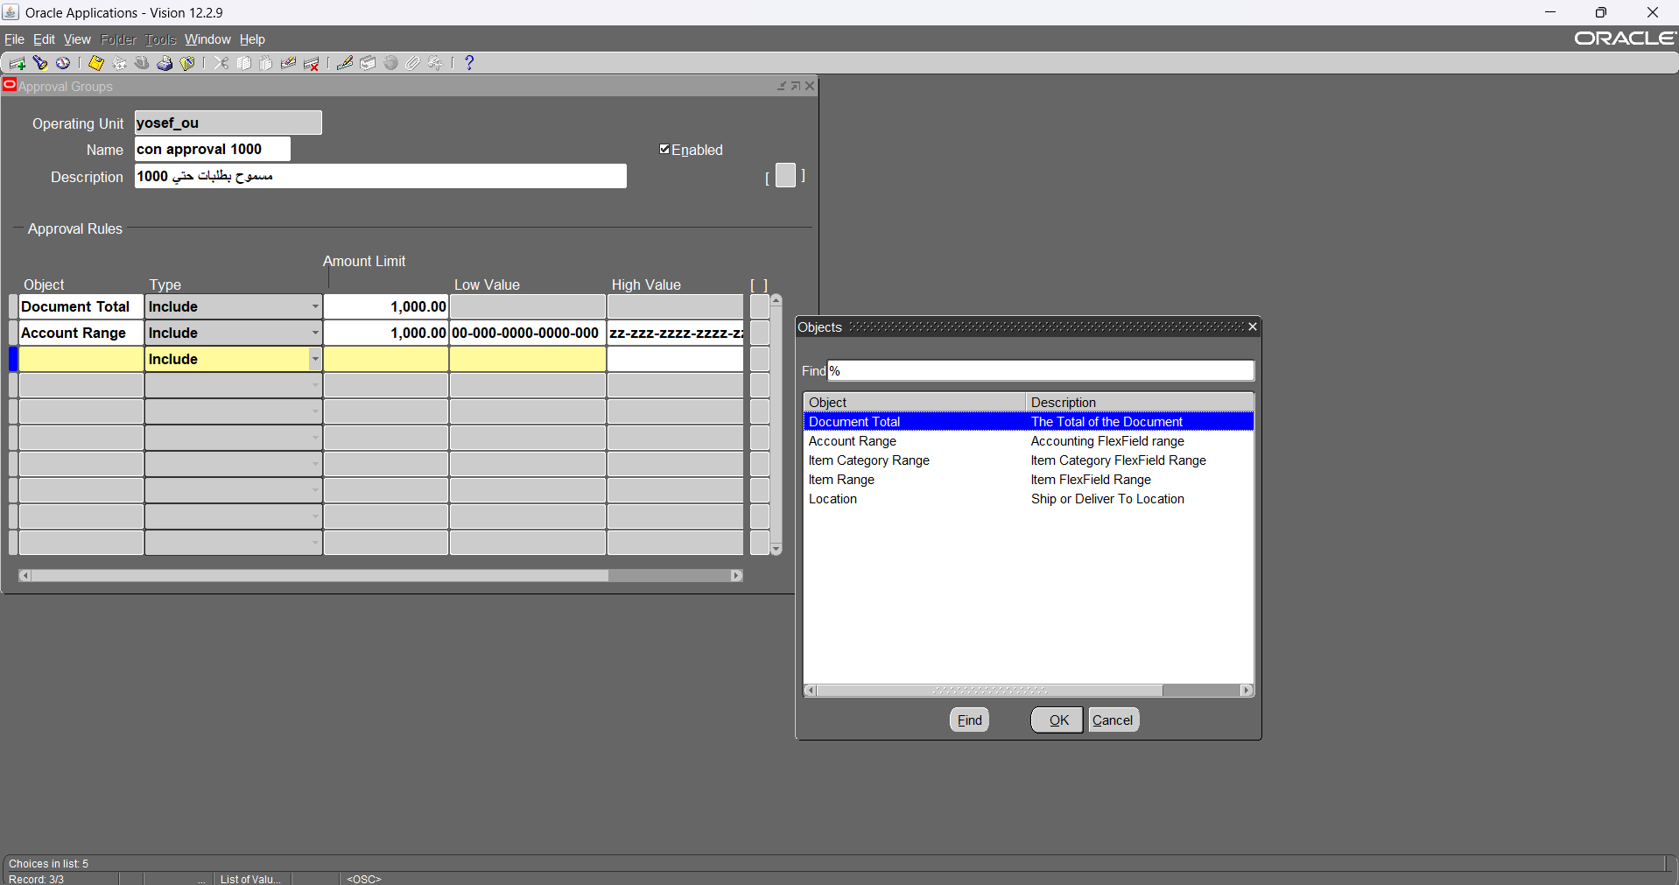

Slide 28
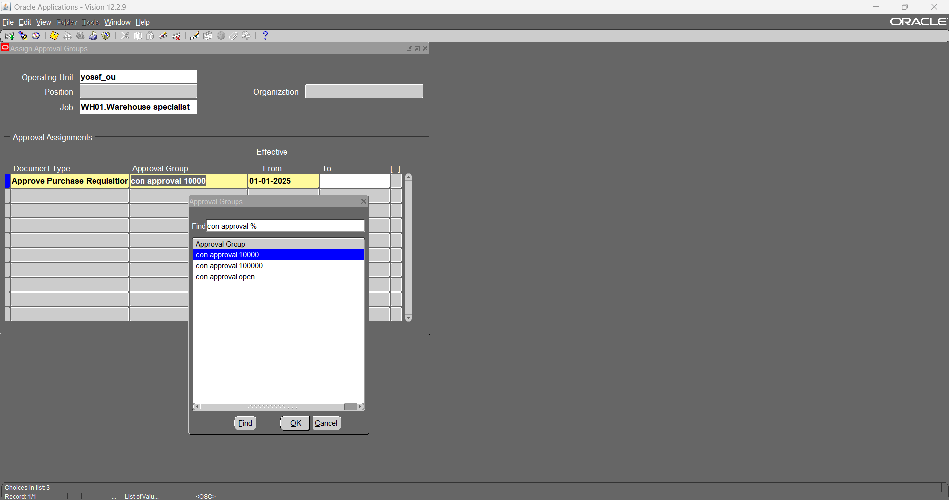
11- Assign approval groups for jobs

Slide 29
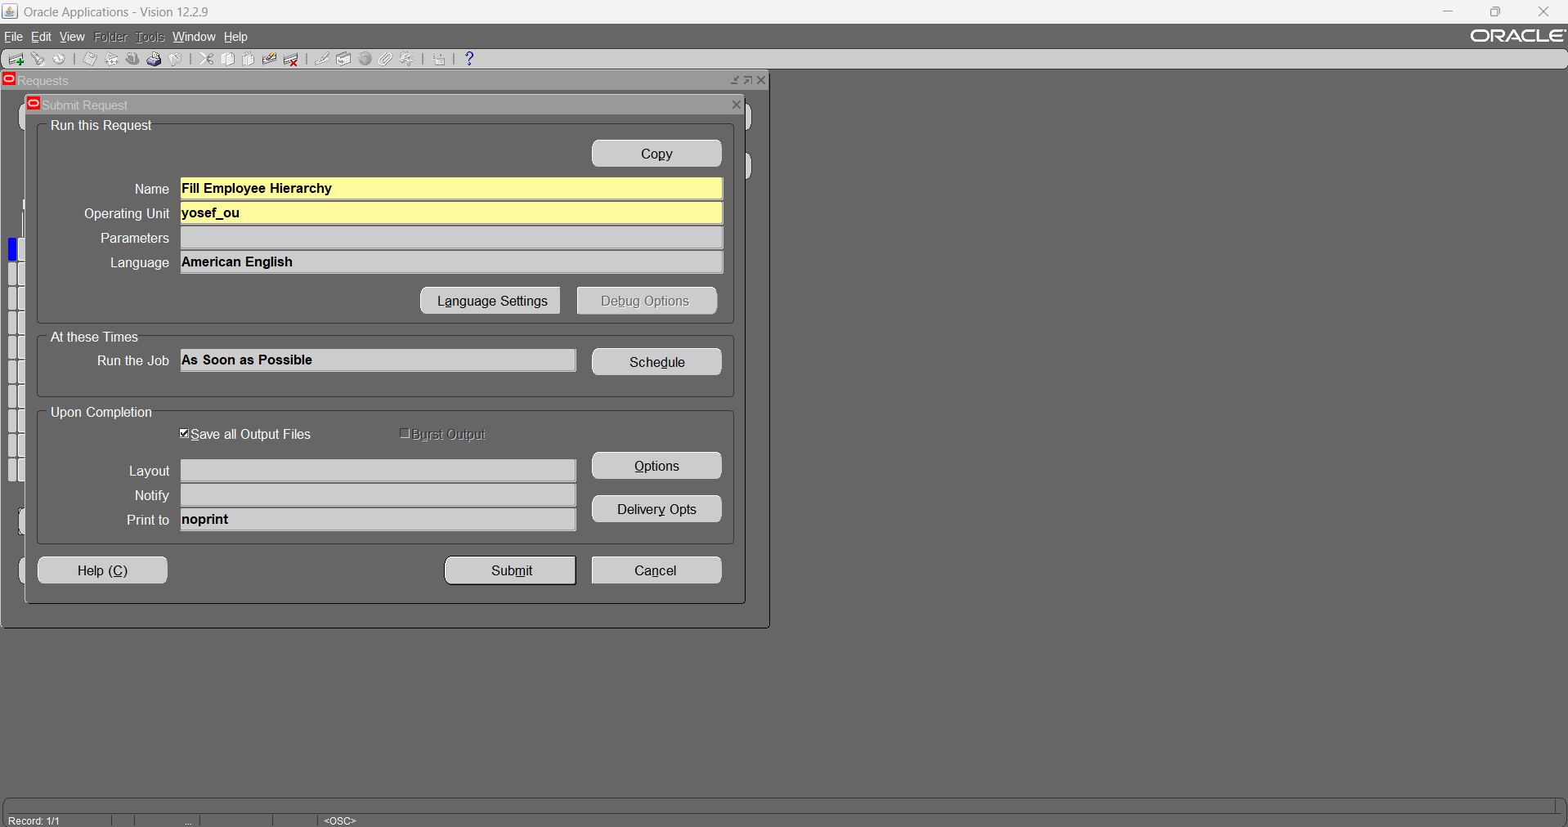
11.1- Run fill employee hierarchy request

Slide 30
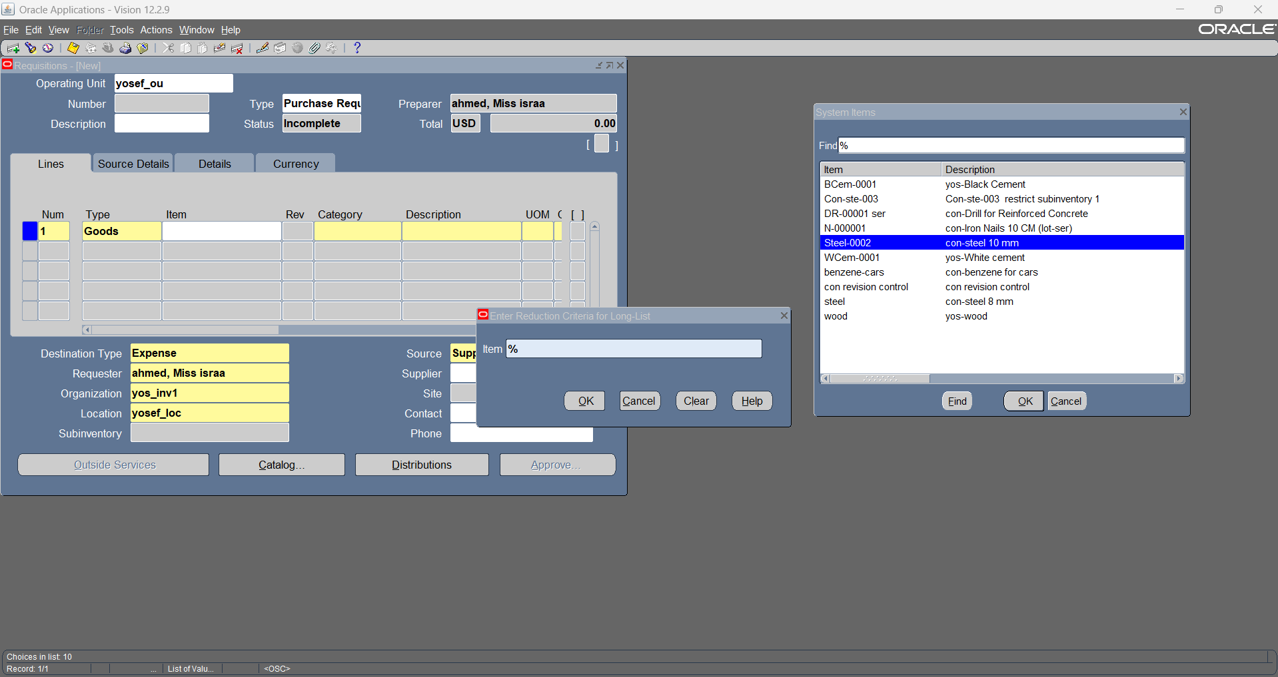
12- Create Purchase requisition (using first approval group)

Slide 31
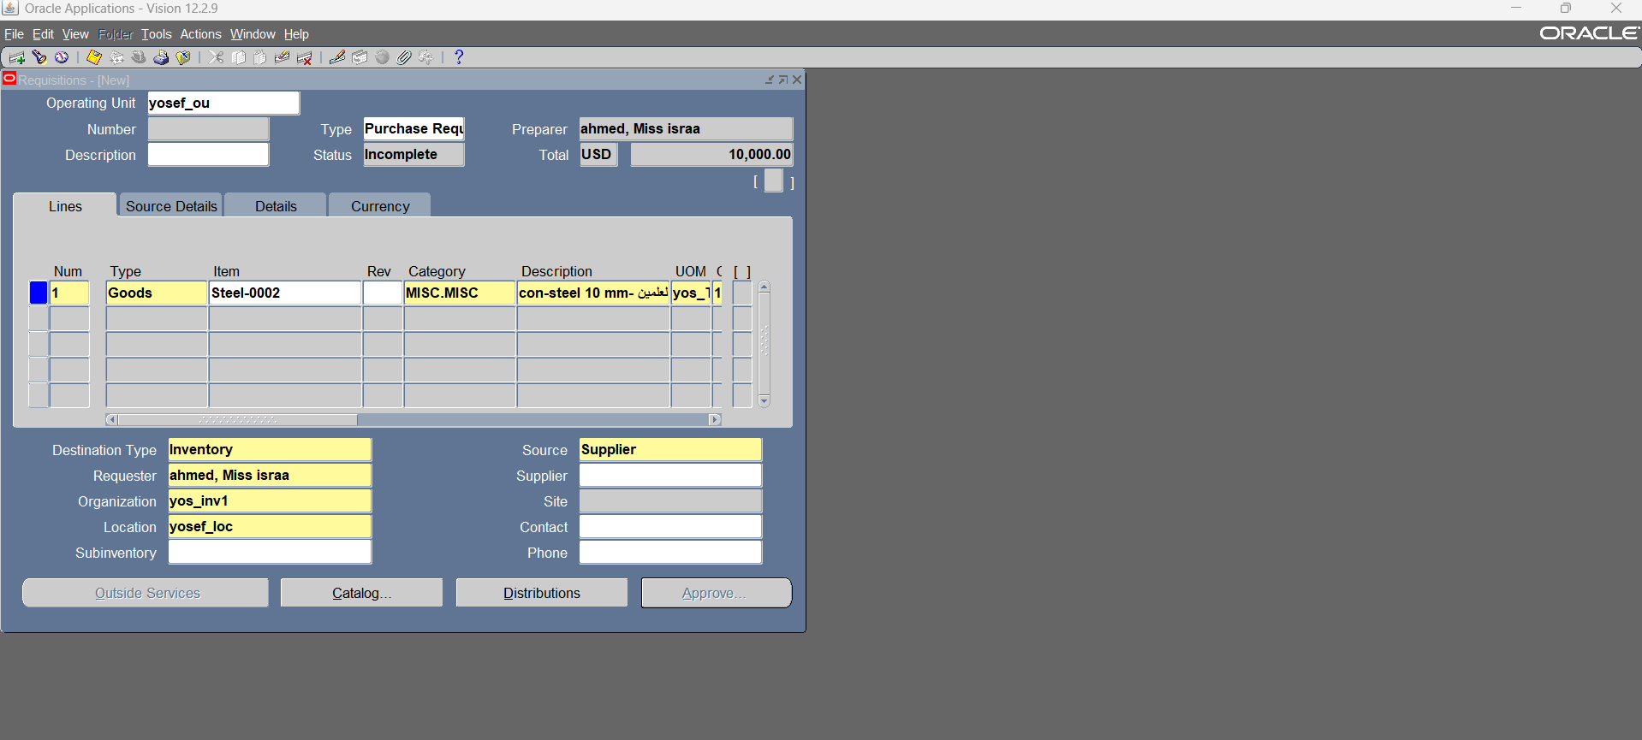

Slide 32
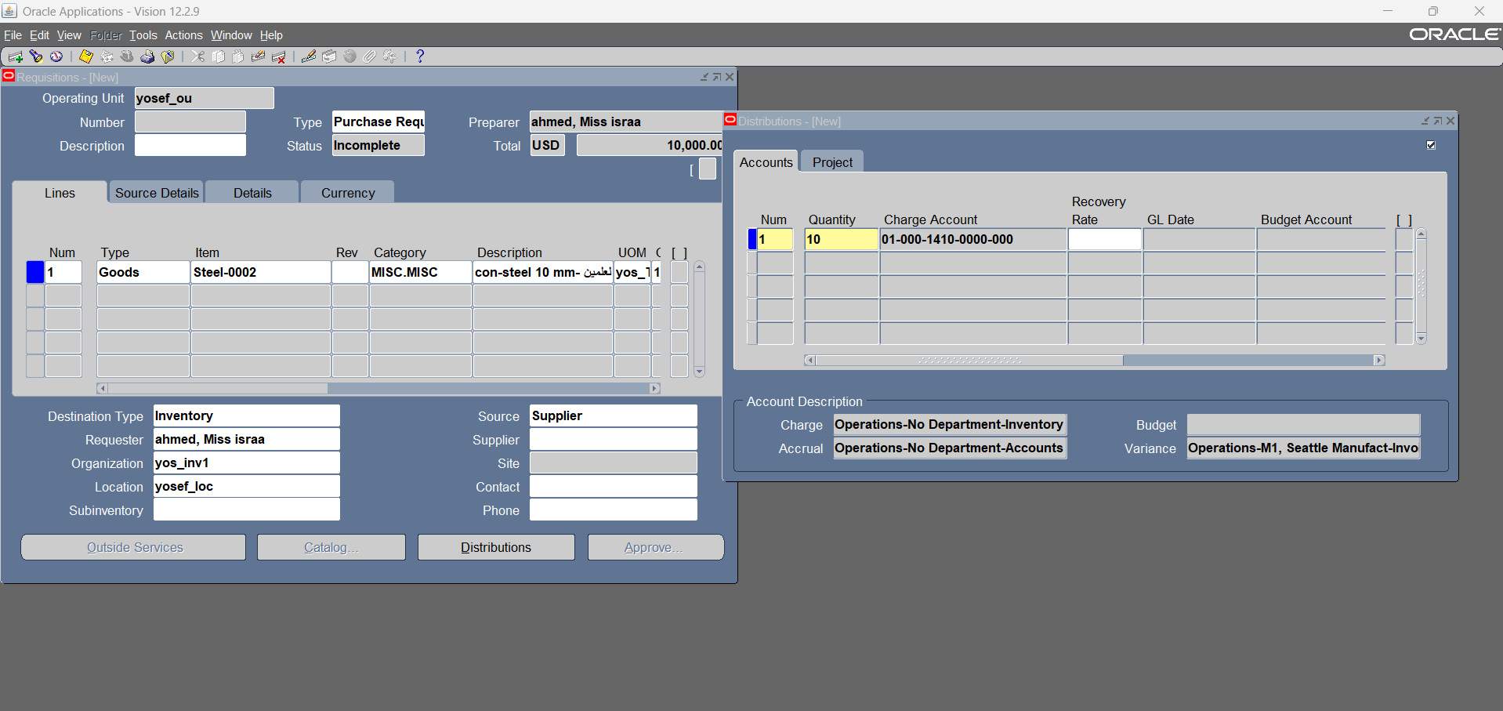

Slide 33
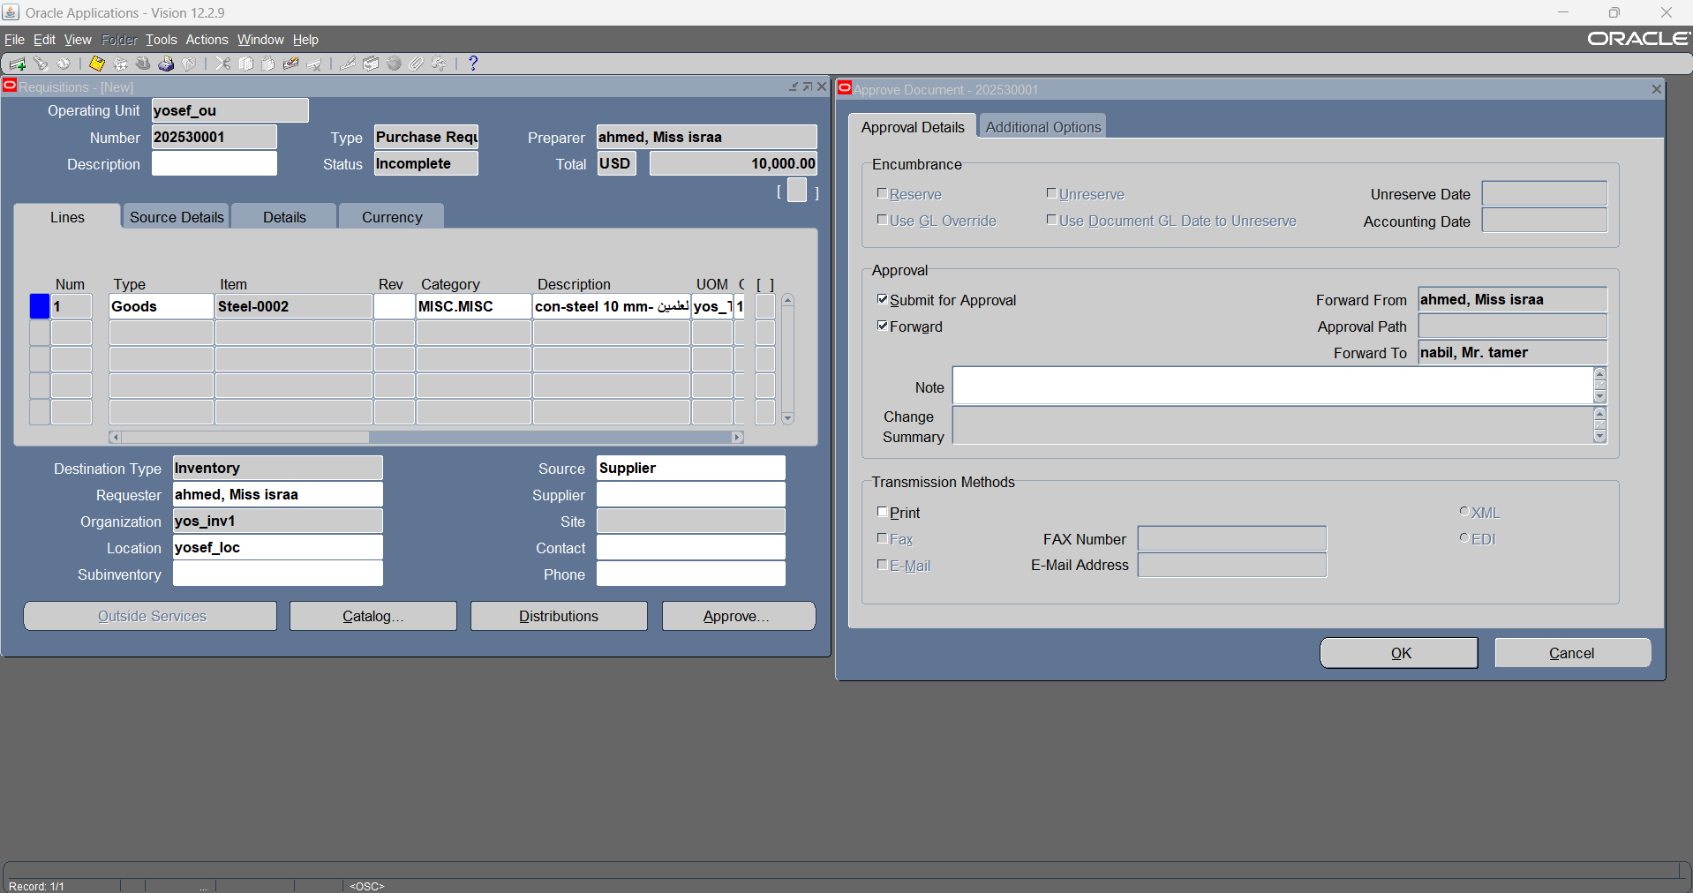

Slide 34
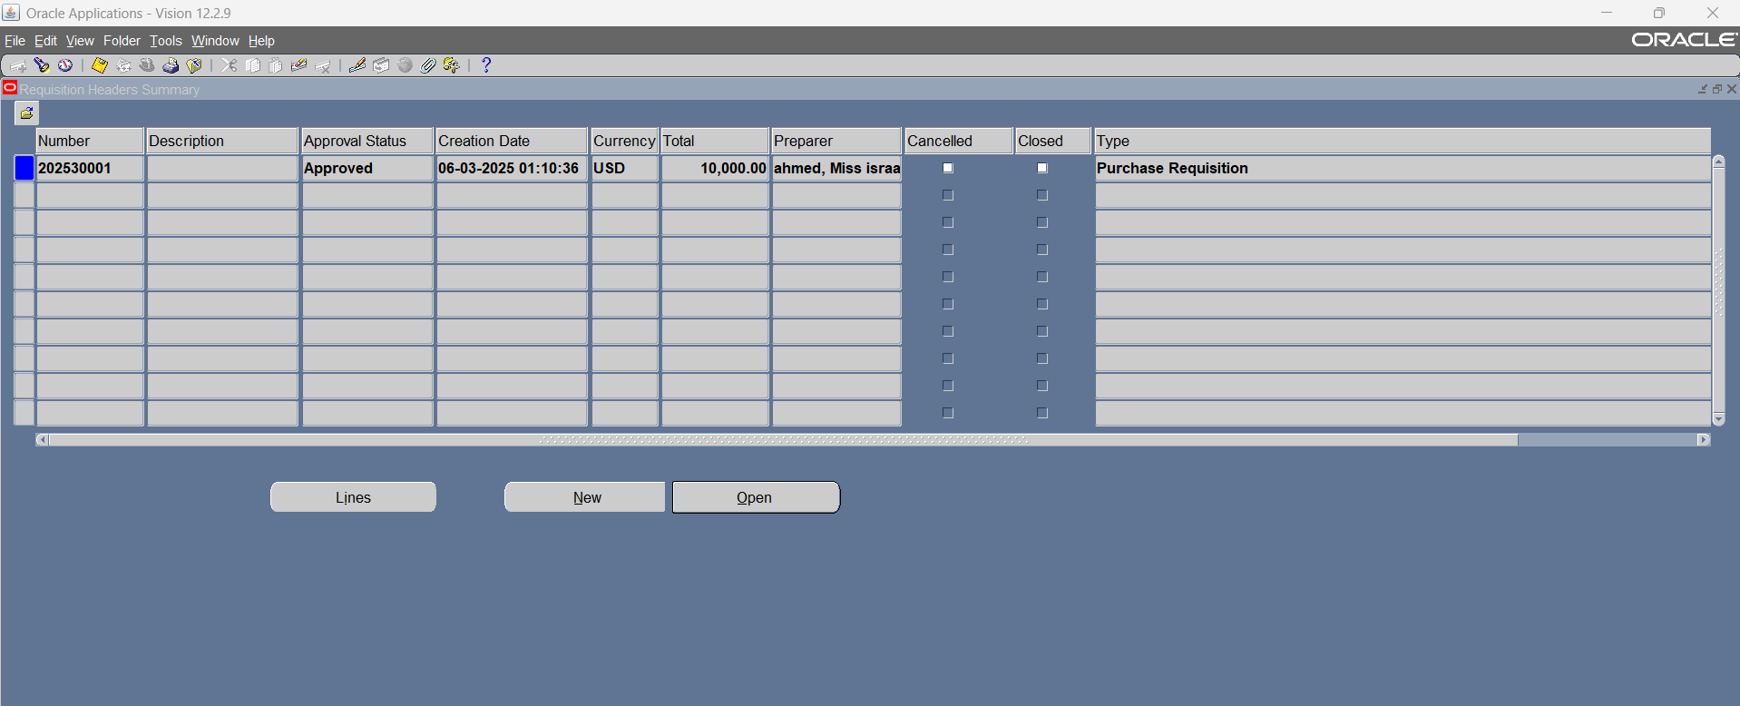

Slide 35
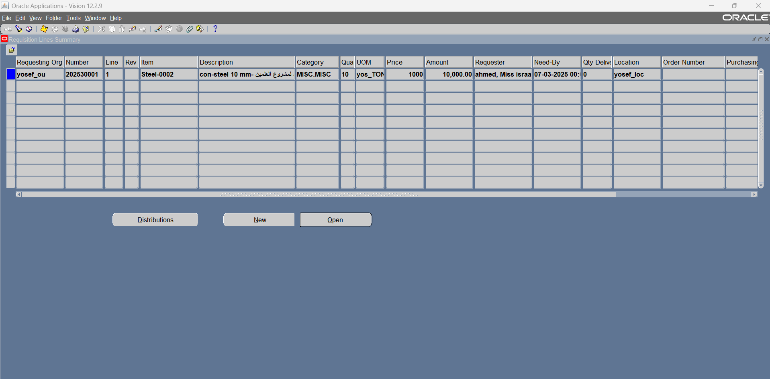

Slide 36
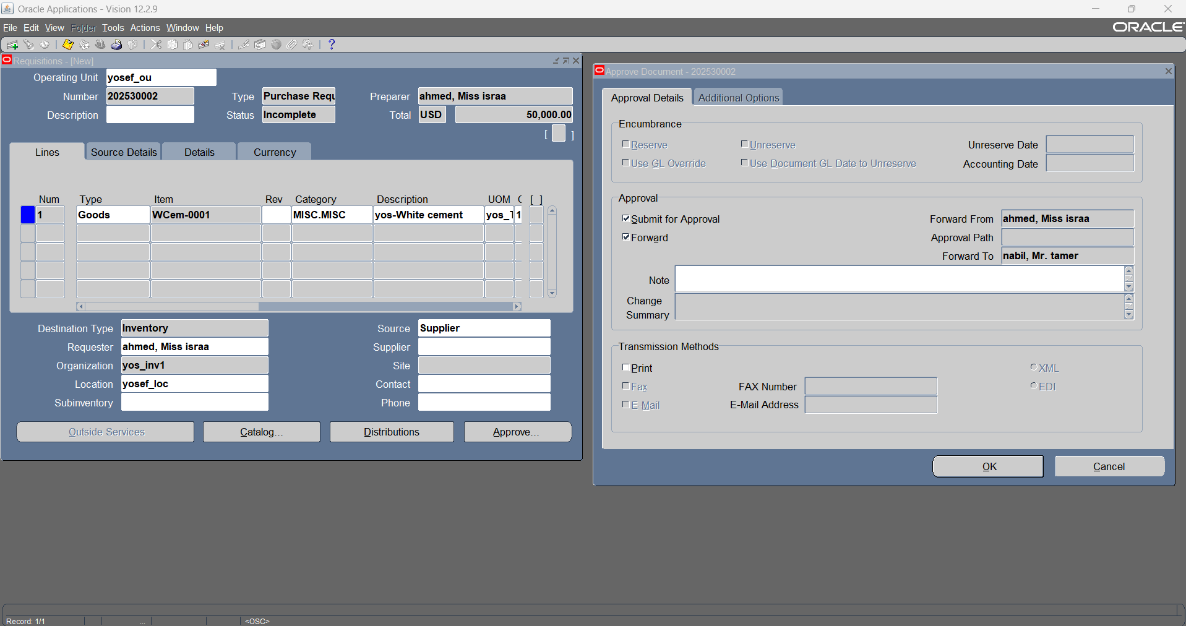
13- Create Purchase requisition (using second approval group)

Slide 37
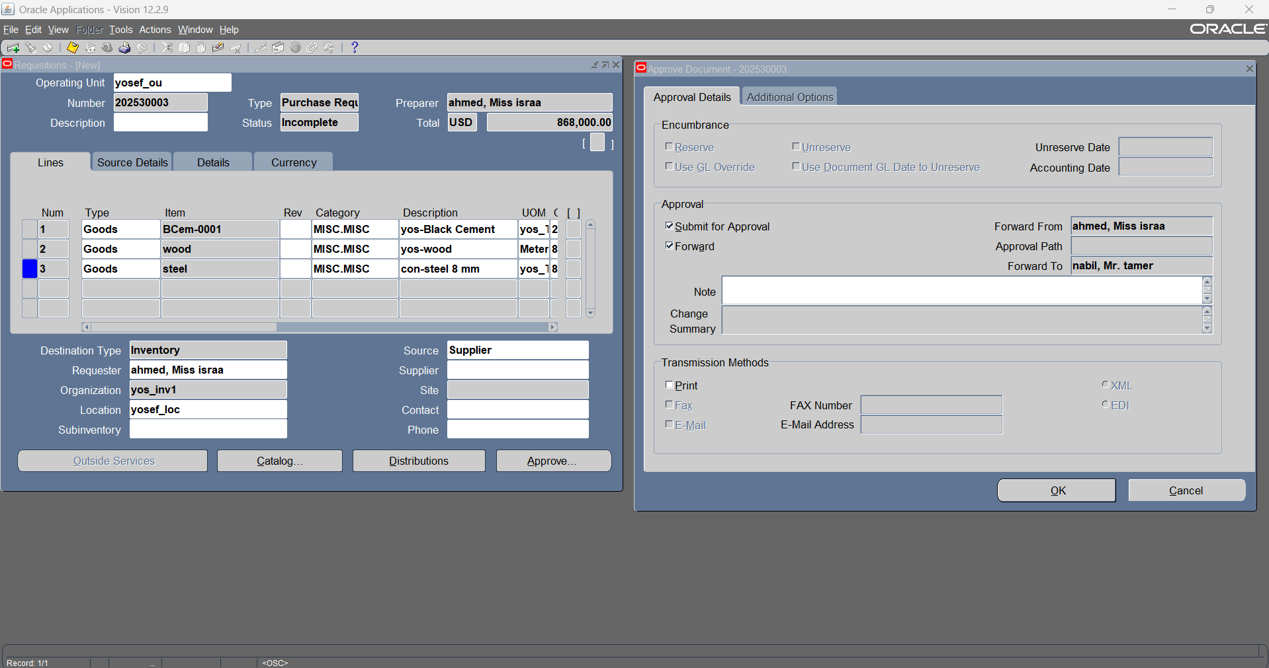
13.1- Create Purchase requisition (using third approval group)

Slide 38
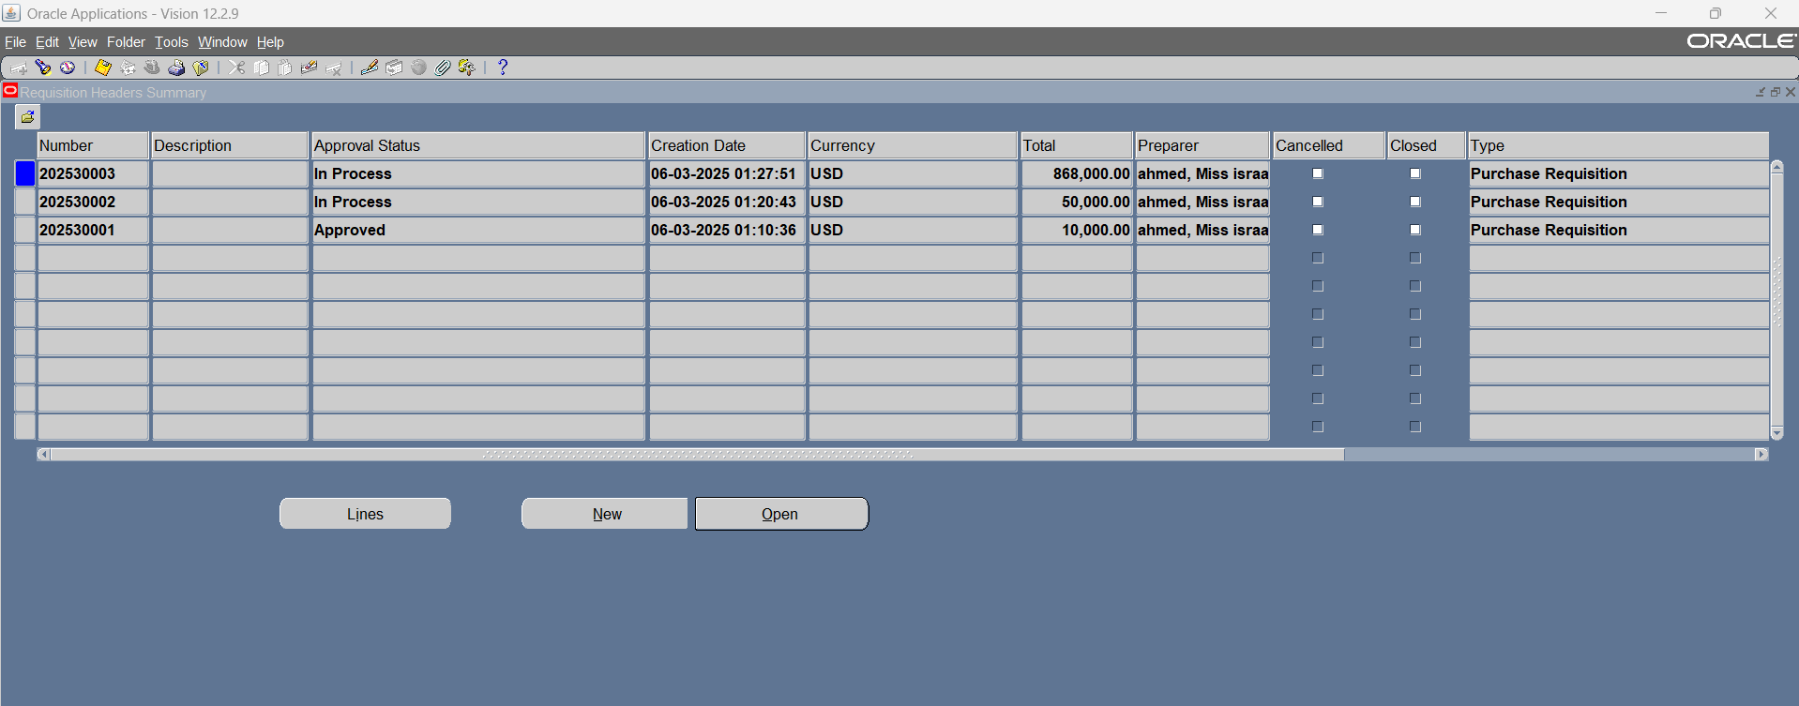

Slide 39
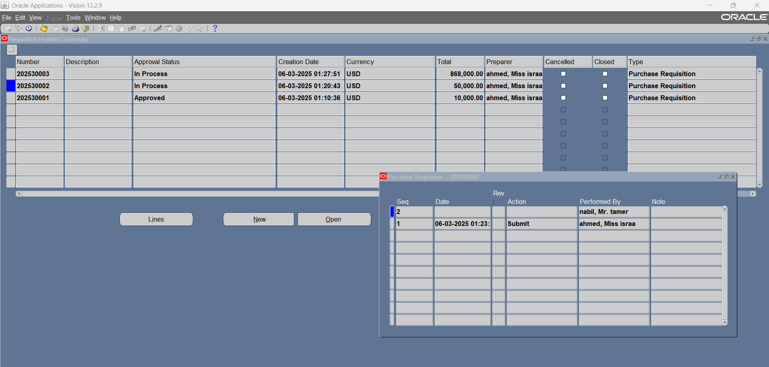

Slide 40
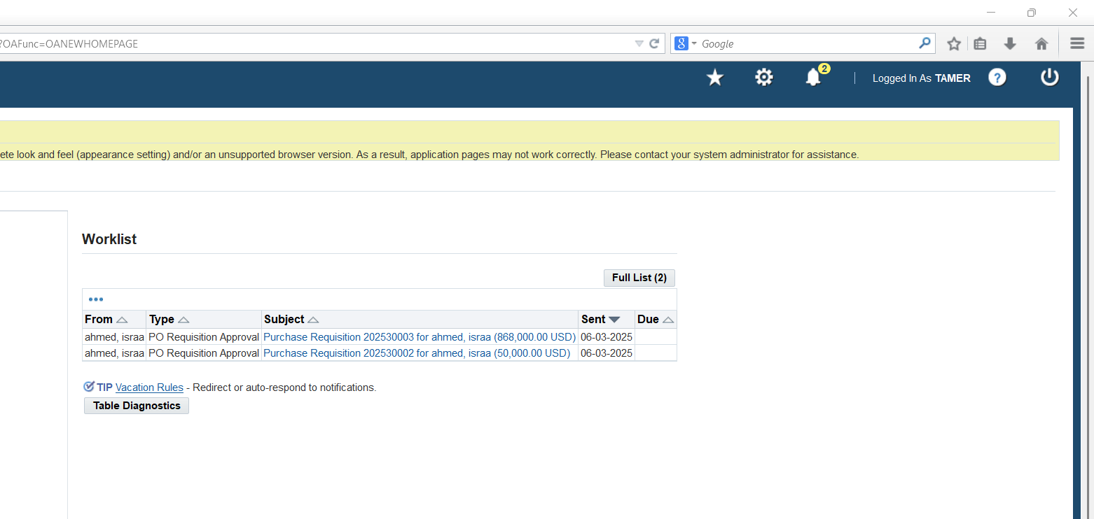
13.2- Notifications sent to first supervisor at supervision approval hierarchy

Slide 41
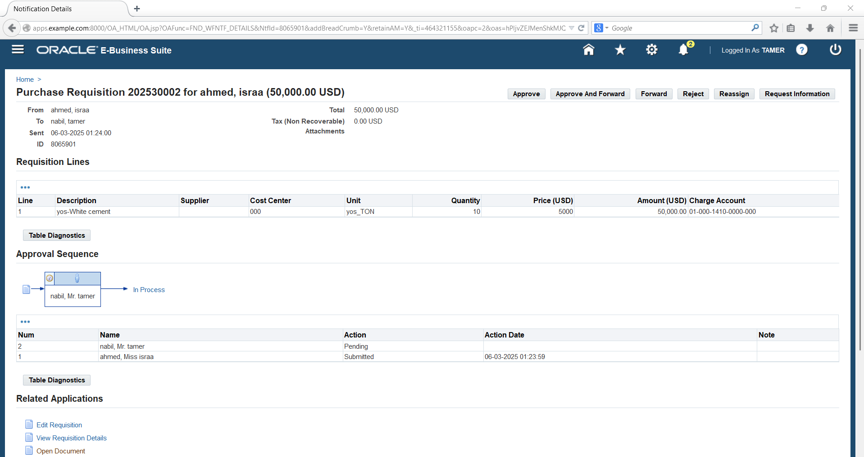
13.3- Approval notification for PR using second approval group

Slide 42
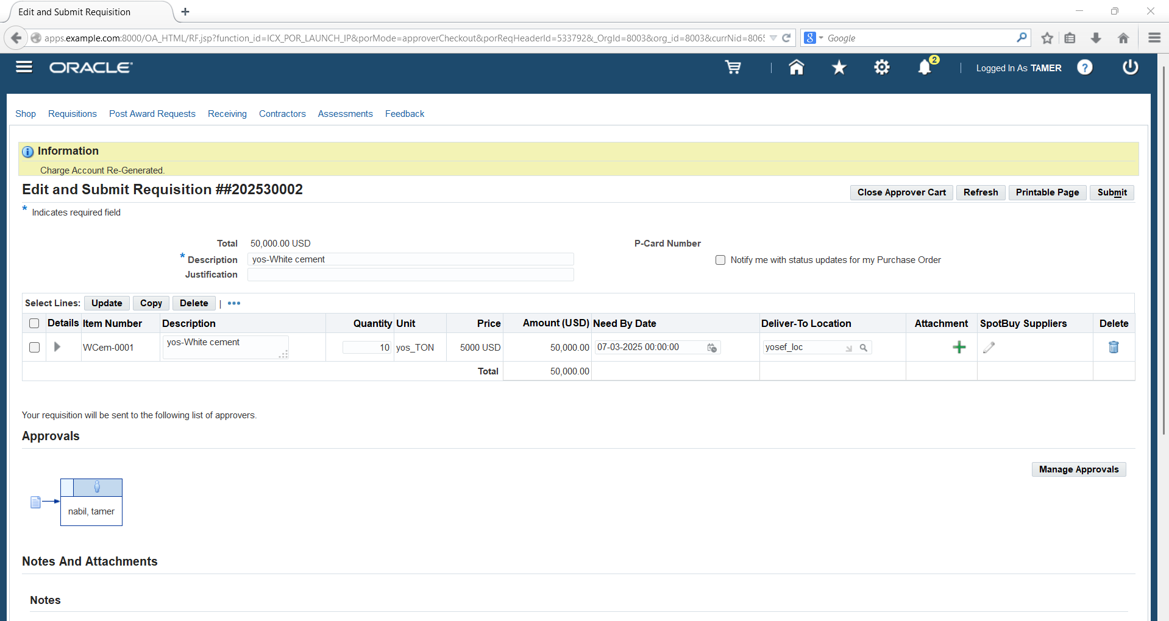
13.4- Edit PR by approver

Slide 43
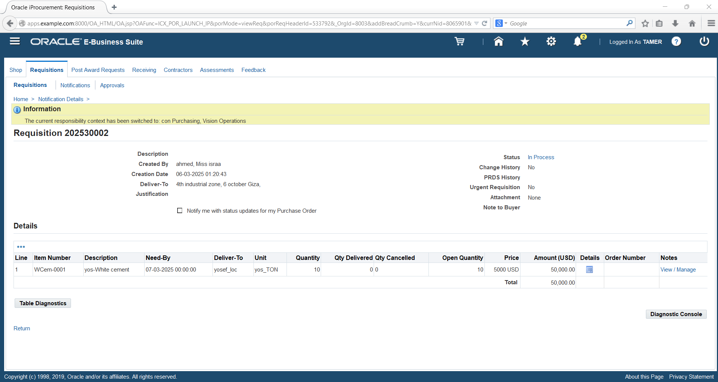

Slide 44
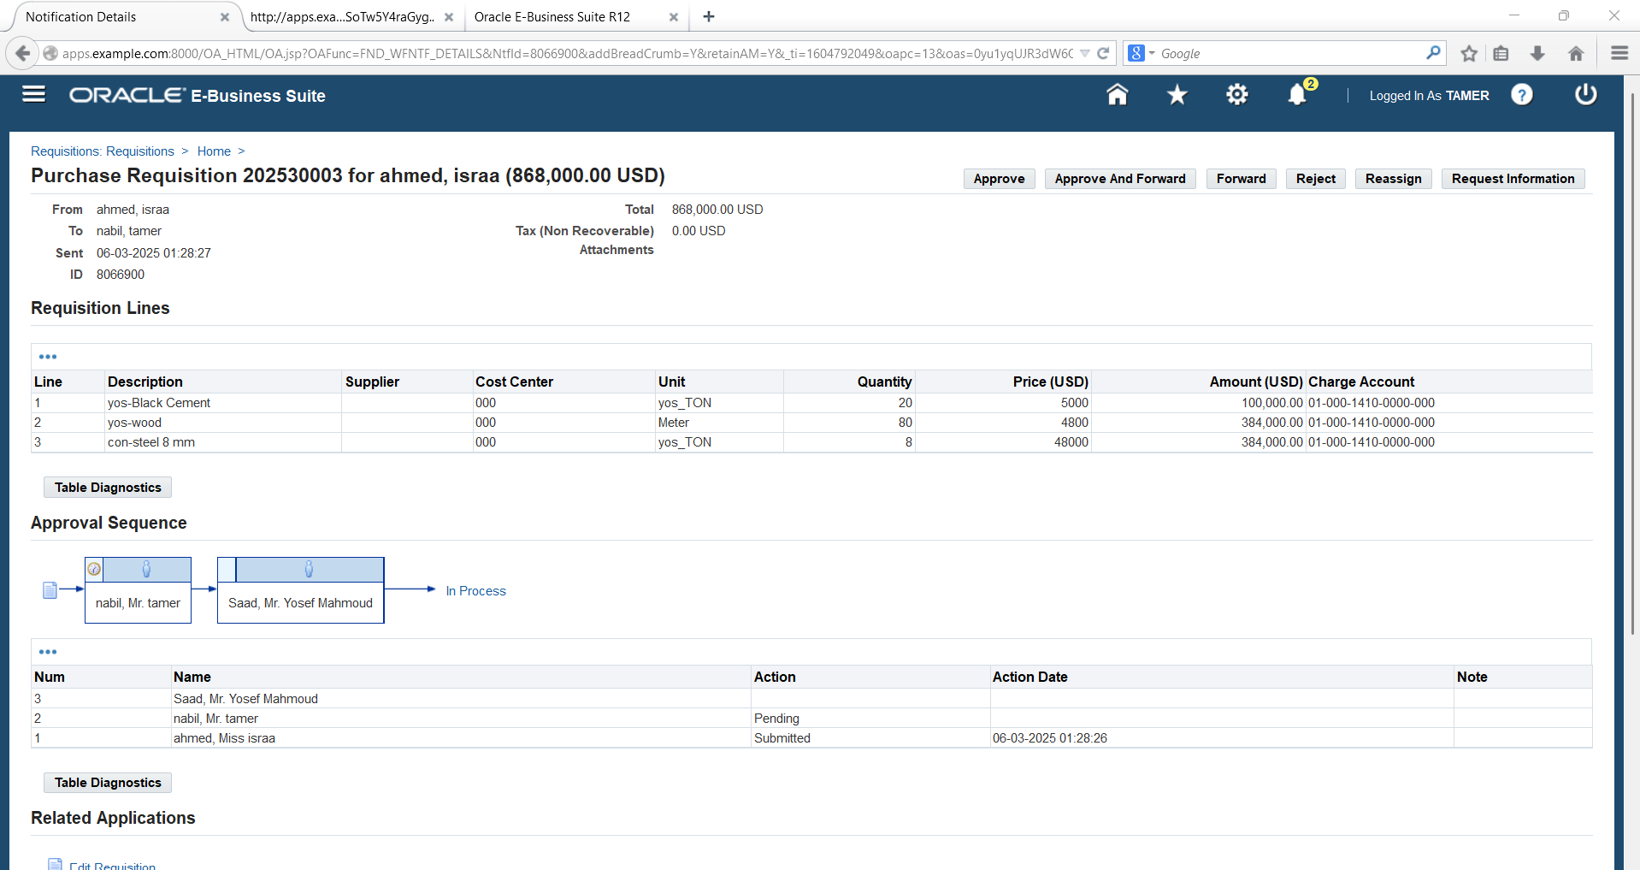
13.5- Approval notification for PR using third approval group

Slide 45
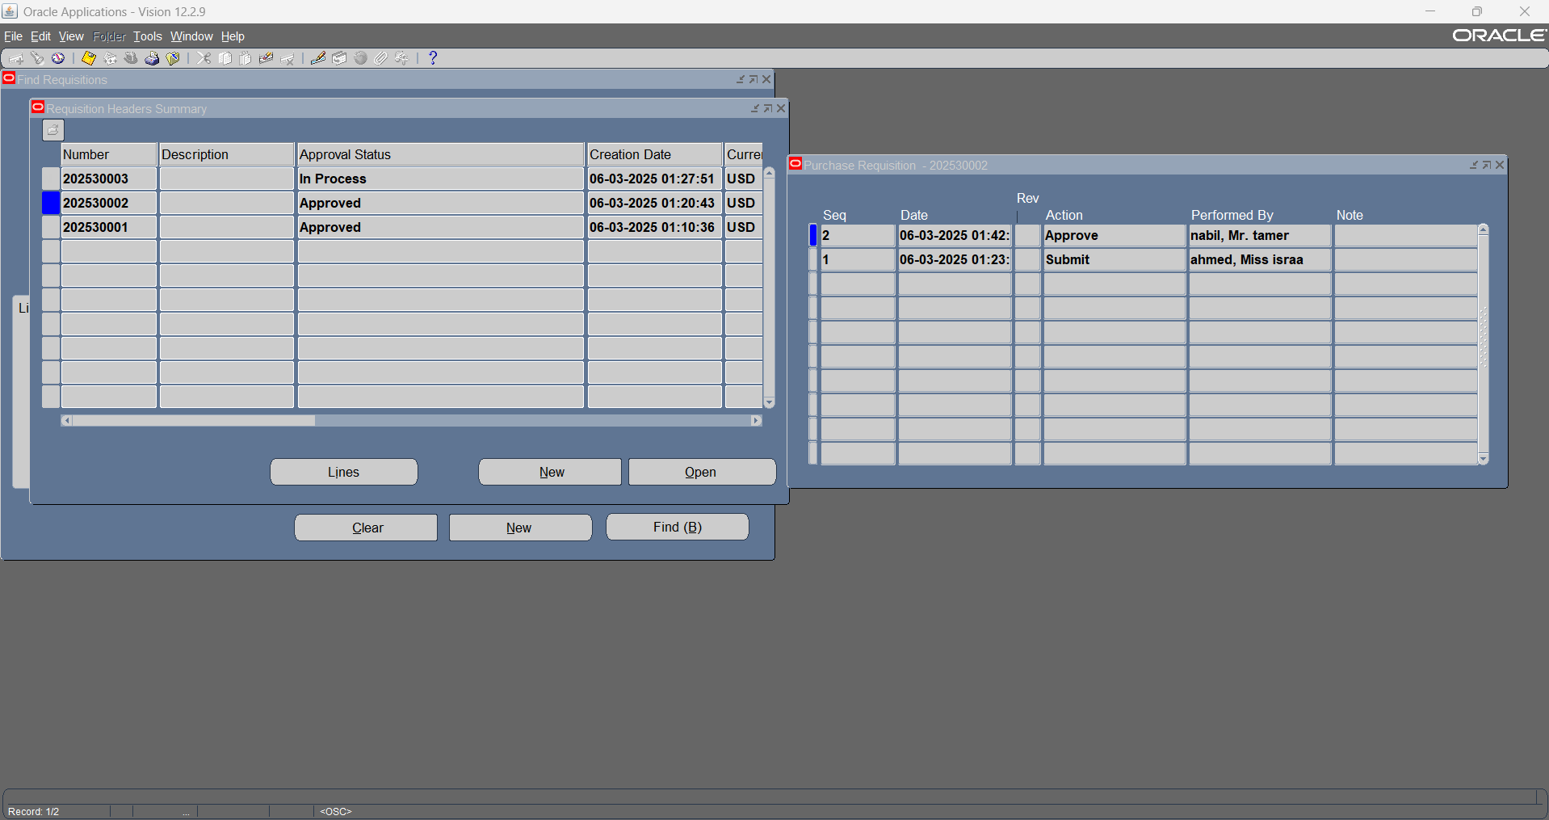

Slide 46
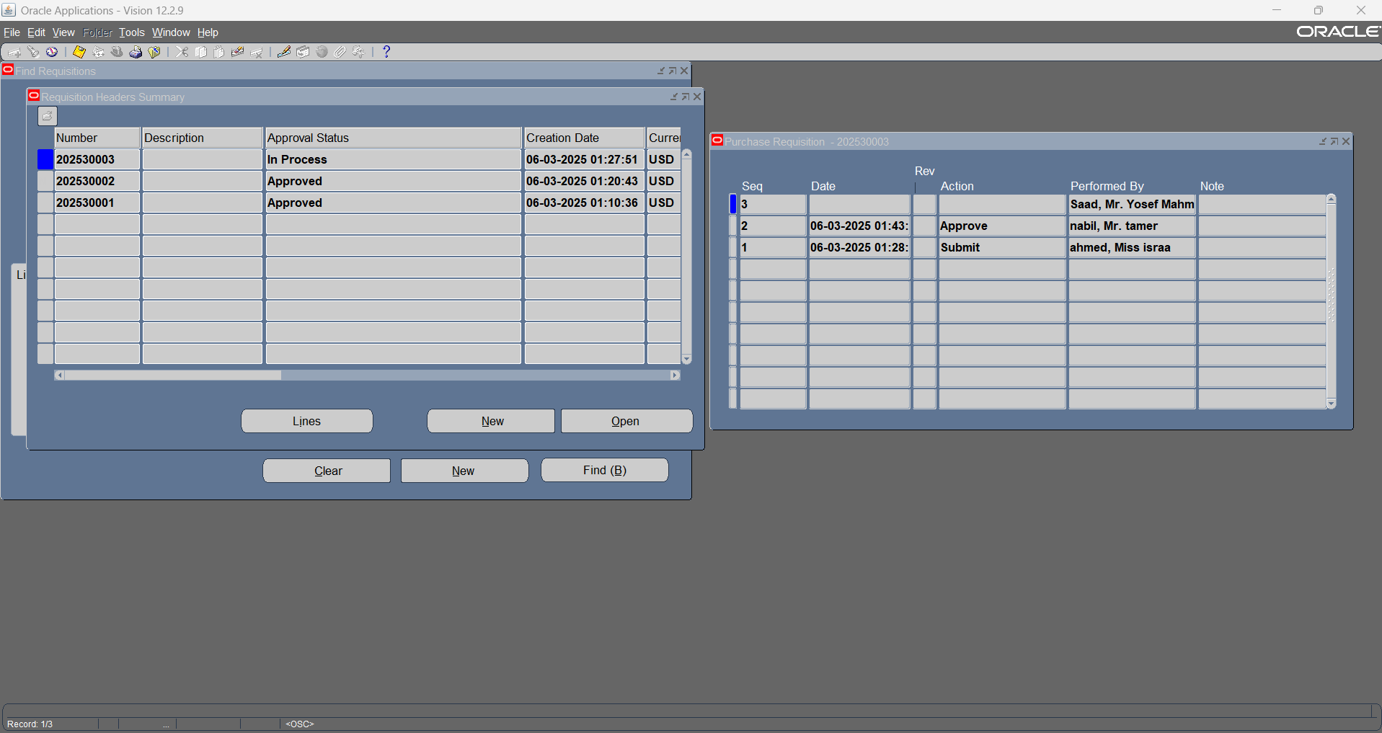

Slide 47
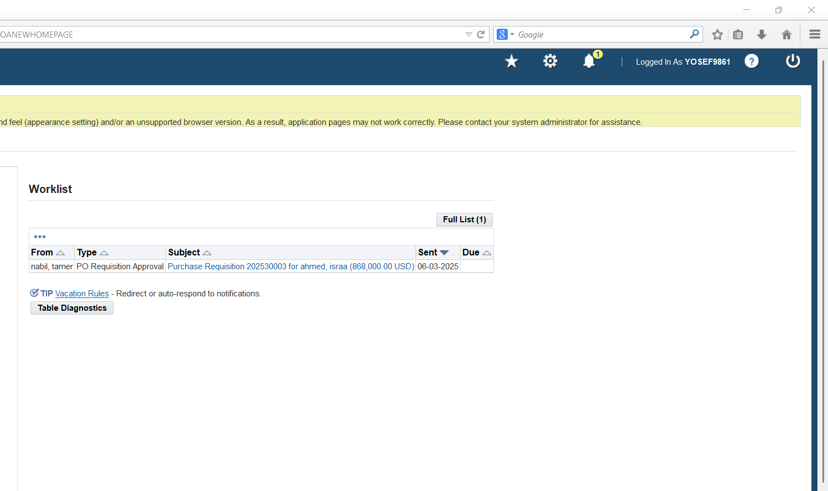
13.6- Notifications sent to second supervisor at supervision approval hierarchy

Slide 48
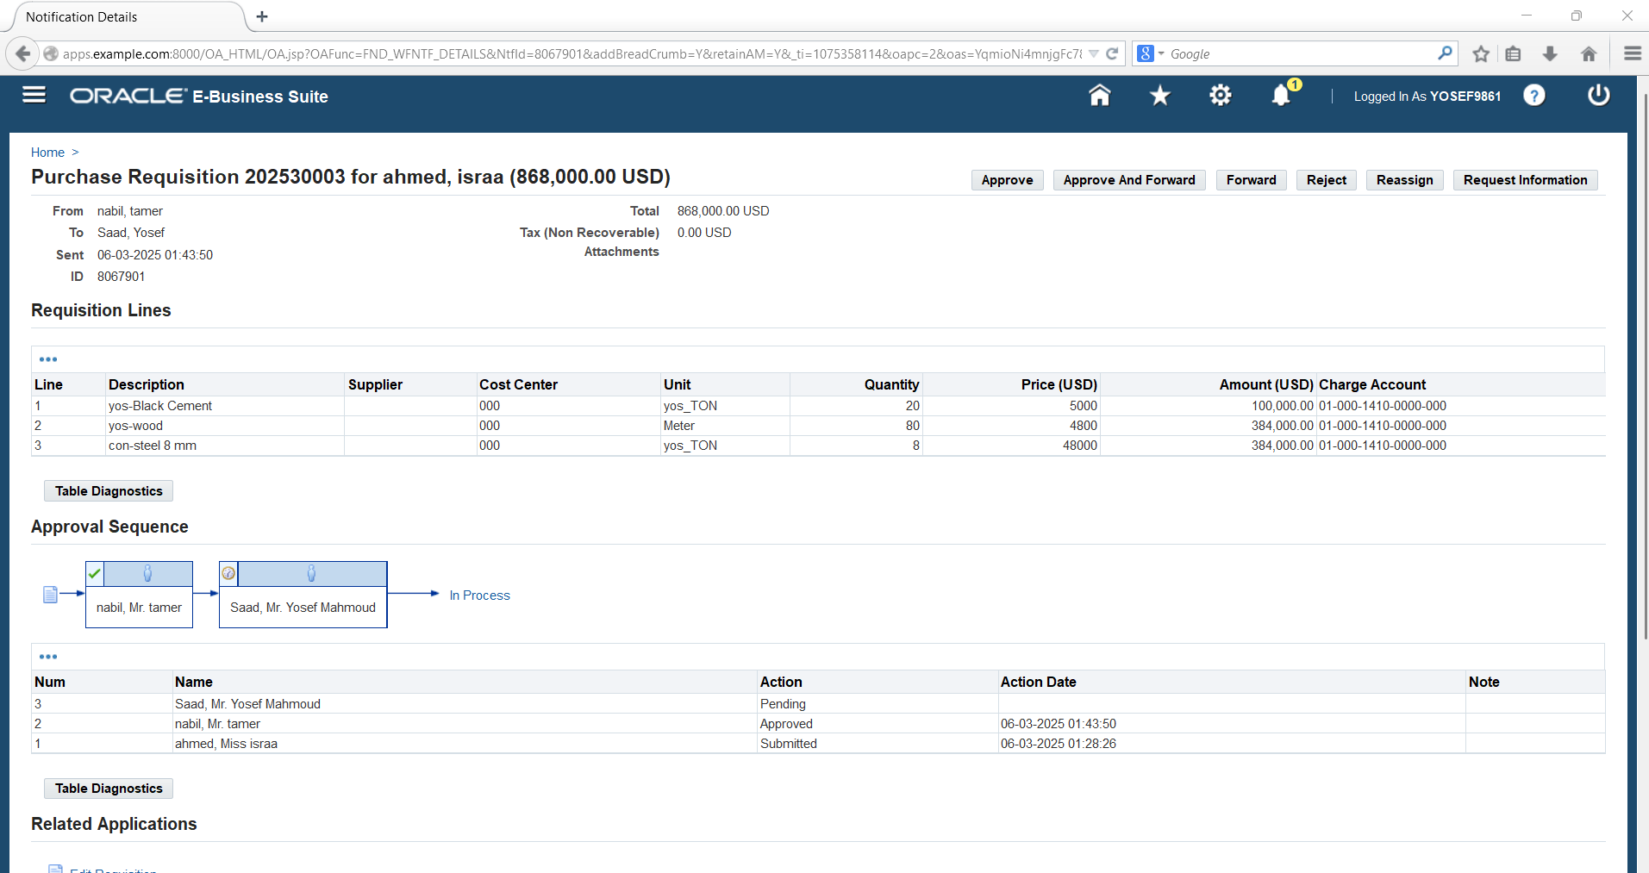

Slide 49
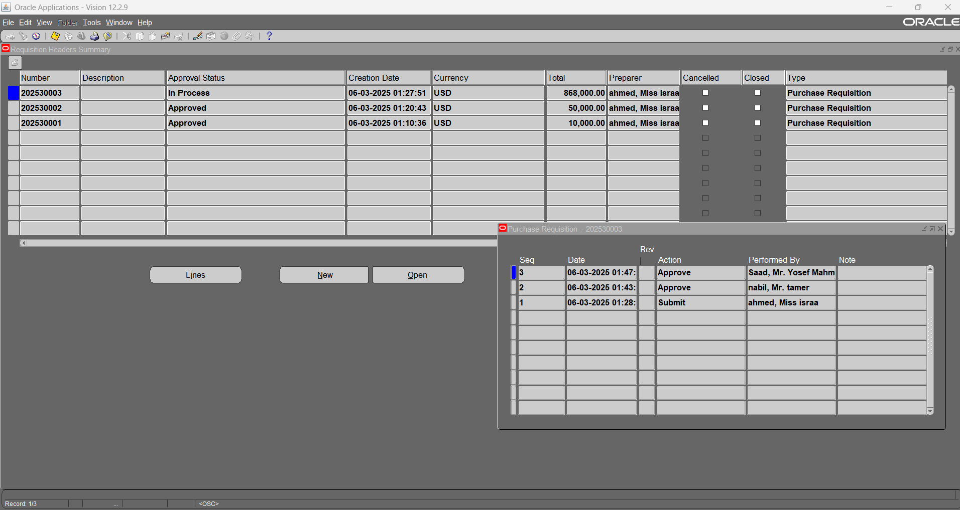

Slide 50
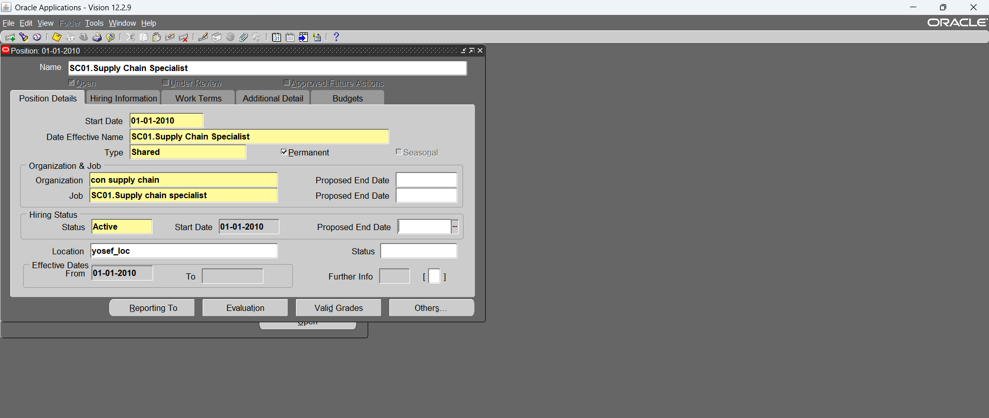
14- Create new positions (to use them at position hierarchy) – type: pooled “two or more people ”

Slide 51
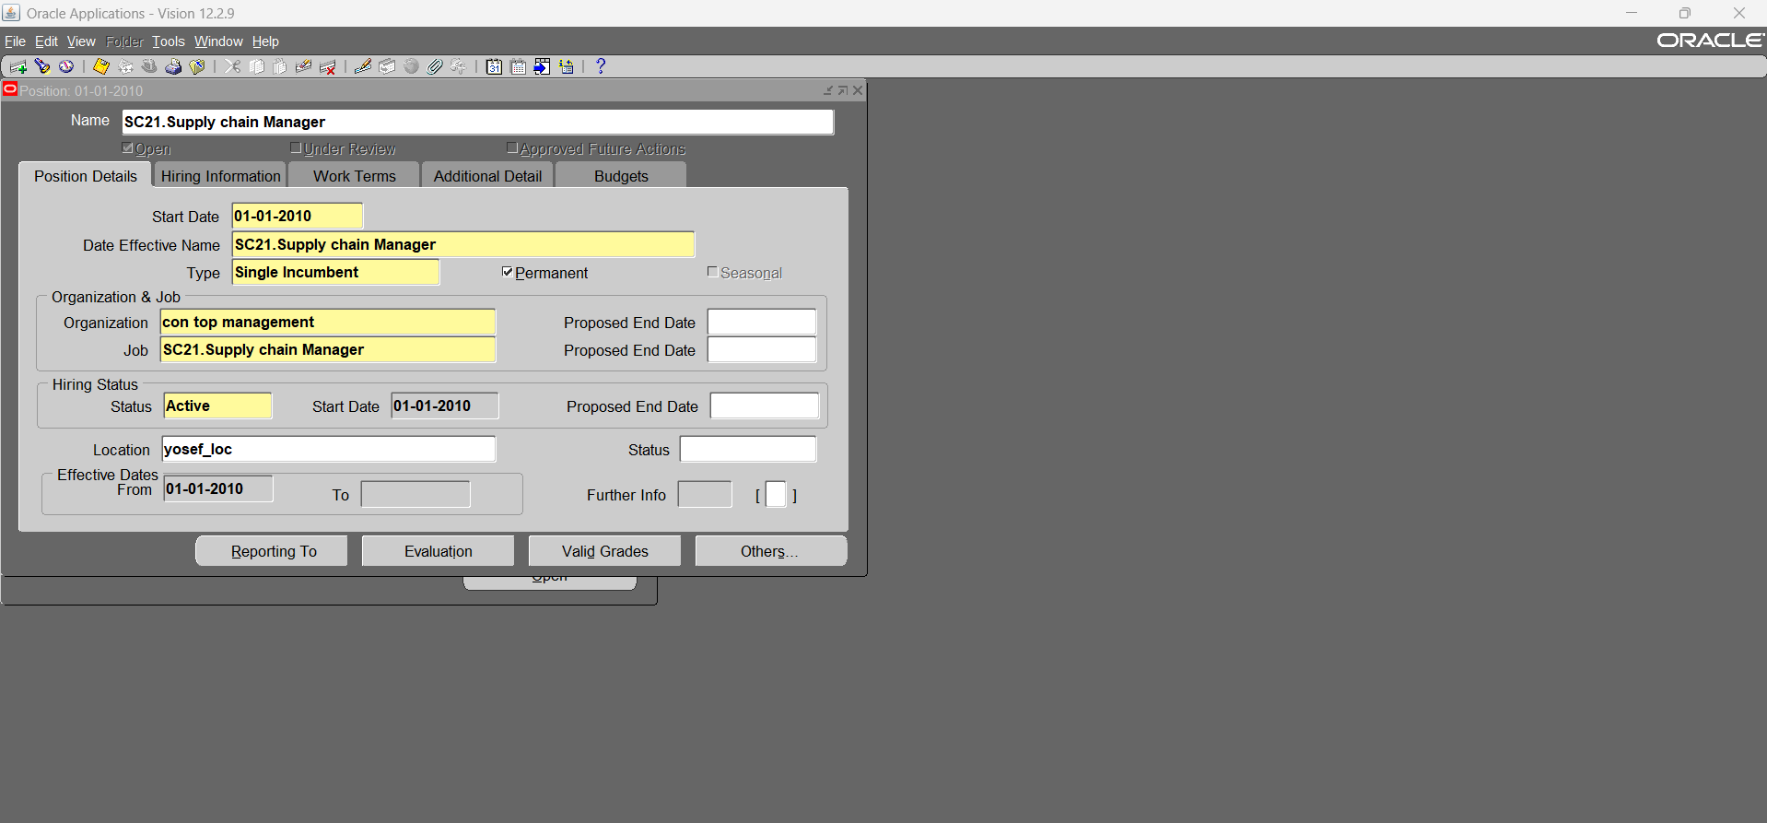

Slide 52
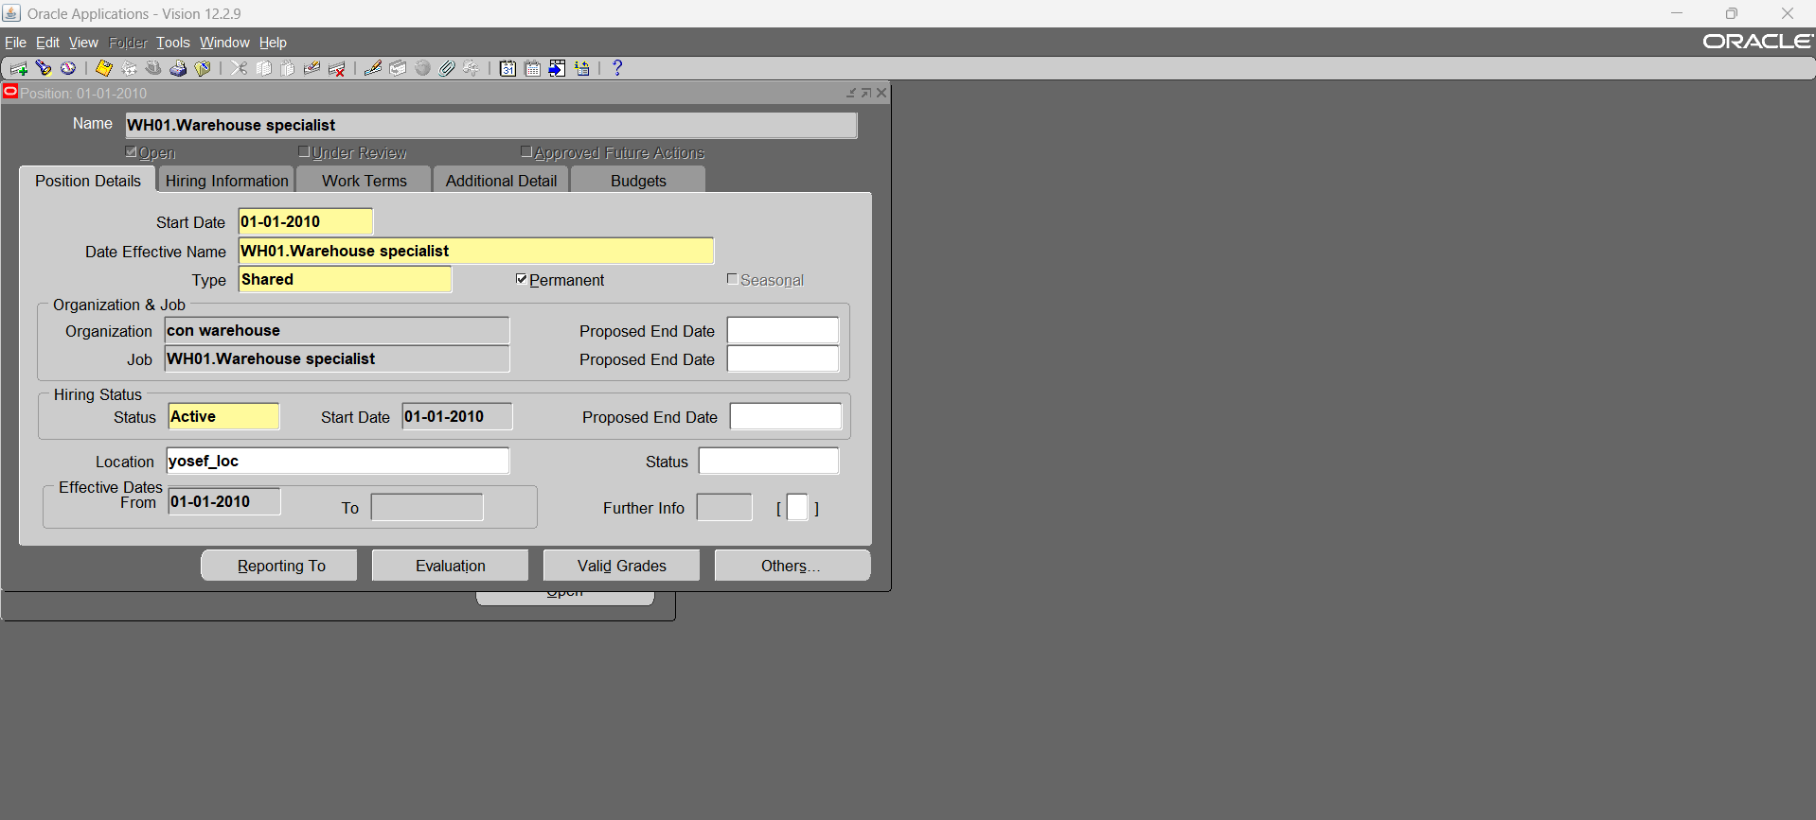

Slide 53


Slide 54

15- Assign the new positions for the employees

Slide 55


Slide 56

16- create new organization hierarchy (Position hierarchy)

Slide 57

16.1- Position hierarchy diagram

Slide 58

16.2- Switch to “activate ” position hierarchy at financial options of the operating unit

Slide 59

17- assign Position hierarchy for purchase requisition document type

Slide 60


Slide 61

18- assign approval groups to positions & document type

Slide 62

19- Create new PR (using the new Position hierarchy – first approval group)

Slide 63

20- Create new PR (using the new Position hierarchy – second approval group)

Slide 64

21- Create new PR (using the new Position hierarchy – third approval group)

Slide 65

22- Create new PR (using the new Position hierarchy – open approval group)

Slide 66


Slide 67

Notifications for first Position at Position hierarchy - first approval group

Slide 68

19.1- first approval group (just forward to)

Slide 69

22.1-

Slide 70

22.2- Open approval group

Slide 71

22.3-

Slide 72


Slide 73


Slide 74

23- Define new Buyers (to be able to create PO)

Slide 75

24- Assign Default Buyer for master items

Slide 76

25- Create new PR using Buyer

Slide 77

26- Create new suppliers

Slide 78


Slide 79


Slide 80


Slide 81


Slide 82

27- Create new PR (contain supplier)

Slide 83

28- Assign approval hierarchy for Purchase Order

Slide 84

29- Create Manual Standard PO

Slide 85


Slide 86


Slide 87


Slide 88

30- Create Standard PO from PR “AutoCreate”

Slide 89

30.1- shipments

Slide 90

30.2- PO approval

Slide 91

31- manage buyer workload (assign new buyer to old PRs) – purchasing, management, manage buyer workload

Slide 92

32- define requisition preferences before creating PR

Slide 93

33- Modify PR Lines (to make more than one PO for the same PR)

Slide 94

34- Return PR to the PR preparer to modify somethings

Slide 95


Slide 96


Slide 97


Slide 98

35- Create Requisition template (to use it at frequently created PRs) – setup, purchasing, requisition template

Slide 99

36- Create PO using Requisition template

Slide 100


Slide 101

37- Receiving items at inventory according to PO (Standard Receipt Routing & Direct delivery)

Slide 102


Slide 103


Slide 104

38- Adjust purchasing options (to use it at Blanket purchase agreement)

Slide 105

39- Assign approval hierarchy to Blanket purchase agreement

Slide 106

40- Assign approval hierarchy to Blanket purchase release

Slide 107

41- Assign approval groups to Blanket purchase agreement & Blanket purchase release

Slide 108

42- Create Blanket purchase agreement

Slide 109


Slide 110

42.1- Blanket purchase agreement approval

Slide 111

42.2- Blanket purchase agreement release

Slide 112


Slide 113


Slide 114

42.3- Rejection of Blanket purchase agreement release (due to minimum release amount)

Slide 115


Slide 116


Slide 117


Slide 118


Slide 119

Blanket purchase agreement release NO. 2

Slide 120


Slide 121

43- Receiving items at inventory according to PO (serial & Locator)

Slide 122


Slide 123


Slide 124


Slide 125

44- Create Standard RFQ (used to create blanket purchase agreement)

Slide 126


Slide 127

45- Convert Standard RFQ to Quotation

Slide 128


Slide 129


Slide 130


Slide 131

46- Create PO from PR (AutoCreate) & link it to a Quotation

Slide 132


Slide 133


Slide 134


Slide 135


Slide 136

47- Create new PR to use it at Bid RFQ

Slide 137

47.1- convert PR to Bid RFQ

Slide 138


Slide 139

47.2- convert Bid RFQ to Bid Quotation

Slide 140


Slide 141

47.3- Create standard PO from Bid Quotation

Slide 142


Slide 143

47.4- Standard PO with Bid Quotation as a reference document

Slide 144

47.5- Receiving items at inventory from Standard PO with Bid Quotation as a reference document

Slide 145

48- Assign approval hierarchy to Purchase agreement Contract

Slide 146

49- Assign approval group to Purchase agreement Contract

Slide 147

50- Create new Contract Purchase agreement

Slide 148

50.1- Contract Purchase agreement approval

Slide 149

51- Define Notification Control for Contract Purchase agreement

Slide 150

52- Create new PO & assign a Contract Purchase agreement to it

Slide 151


Slide 152


Slide 153

Contract Status Report

Slide 154



CONSTRUCTION COMPANY
Thank you.
Instructor: Mohamed Abdelrehim
Team Number: G1
Training Partner: Next Academy
Team Members:
Tamer Nabil Essawi
Youssef Mahmoud Saad
Israa Ahmed Mahmoud
Soad Said Ameen
Mohamed Fawzy Abdelfattah
Osama Sayed Abdullhameed

Slide 155
Thank you.

